Slide 1


Modern assessment of lung disease
Dr Alex Horsley
NIHR Clinician Scientist
Senior Lecturer, University of Manchester
Honorary Consultant, Manchester Adult CF Centre

Slide 2
Multiple breath washout
Follow the concentration of an inert tracer gas washed from the lungs during tidal breathing
  Helium, SF₆
  Nitrogen → washed out by breathing O₂
As airways become diseased, distribution of ventilation in the lungs becomes uneven
  ⇨ Changes how tracer gases are washed out
Hyperpolarized Helium MRI scans of CF lungs
Mentore et al., Academic Radiology 2005; 12: 1423-9

Slide 3
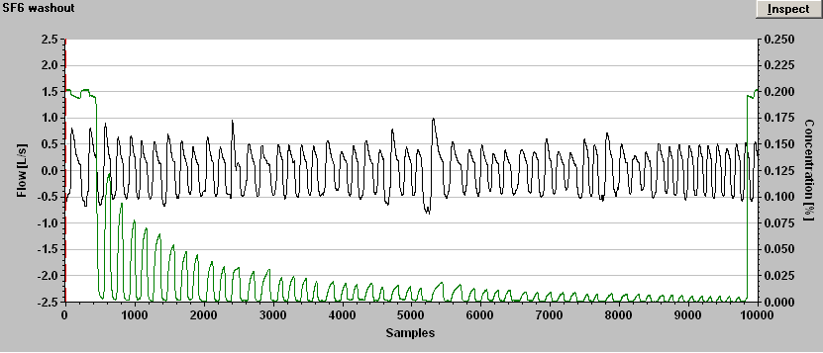

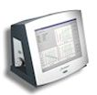
Performing a multiple breath washout test
Flow
x3
SF₆
Flowpast circuit
Flowmeter
Gas signal
Flow
signal
Gas
Cylinder
Subject
Analyser
0.2% SF₆ in air
Patient lungs

Slide 4
Assessment of MBW
Flow
(L/s)
SF₆%
1/40th
1. Volume of tracer gas Volume in lungs at start (FRC)
2. Total volume expired to end of washout = CEV
LCI = CEV/FRC

Slide 5
Lung Clearance Index
Cumulative expired volume
(required to wash out the tracer to 1/40 of starting concentration)
Functional Residual Capacity
(= volume of air in lungs at start of washout)
=
= Number of lung volume turnovers required to wash out the SF₆

Slide 6
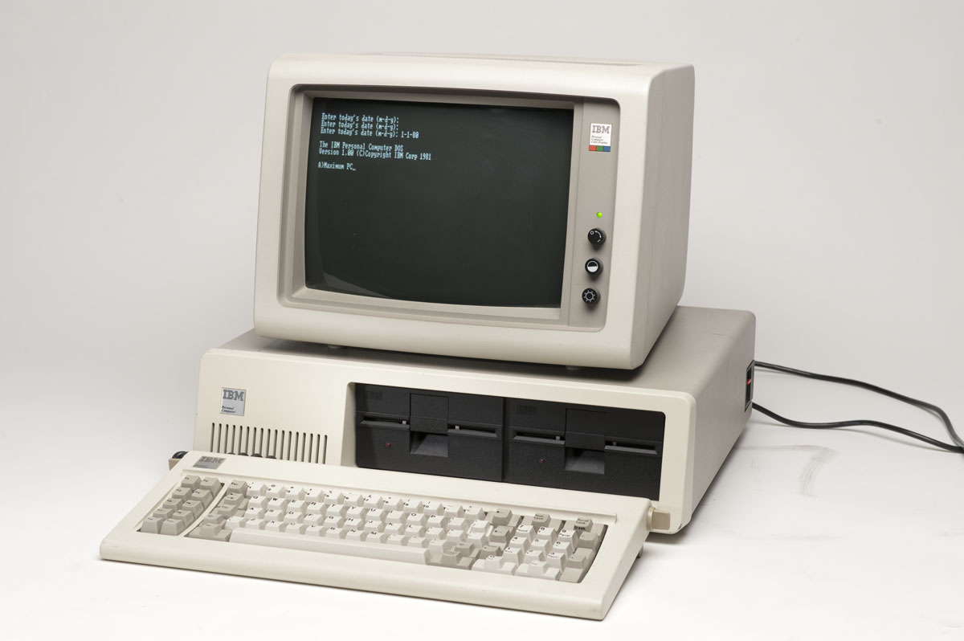
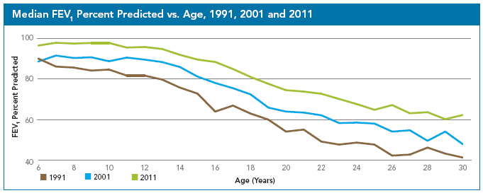
Not strictly a modern technique...
First described in the 1950’s using Nitrogen as the tracer gas and O₂ to washout

Slide 7
LCI is a sensitive marker of airways disease in children
Cystic fibrosis
Healthy controls
Normal range FEV₁
Elevated LCI
22 CF children
33 healthy control
Age 6-16yrs
Aurora et al. Thorax 2004; 59(12): 1068

Slide 8
LCI in CF becomes abnormal shortly after birth
Cystic fibrosis
Healthy controls
1yr old
Evidence of airways inflammation in BAL of CF infants
Increasing interest in early identification, & aggressive treatment of airways inflammation
Lung Clearance Index
0
100
Postnatal age (weeks)
Lum et al. Thorax 2007; 62: 341

Slide 9
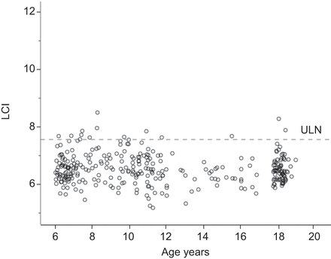
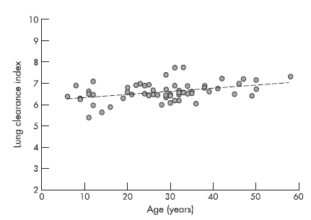
LCI has a narrow range of normal across different populations & ages
Children,
3 centres
LCI range fixed 6-20yrs
Lum et al, ERJ 2013
Adults & children,
LCI range
fixed >20yrs
Horsley et al, Thorax 2008

Slide 10
Key features of LCI
More sensitive than FEV₁
  Infants through to adults
Repeatable & reproducible
User friendly
More sensitive to CT changes than spirometry
  85-94% for CT changes vs 19-26% for FEV₁
More sensitive to effects of treatments
  HTS
  DNase
  Ivacaftor
  Not IV antibiotics
Narrow range of normal, essentially fixed
But....
Non-specific
More complicated than spirometry

Slide 11
Usefulness of different lung function measurements
Lung
Function
LCI
FEF₂₅₋₇₅
FEV₁
Disease progression

Slide 12
MBW technologies
Original studies largely based on mass spec
  Not suitable for clinical work
Newer N₂ washout systems
  No wash-in
  Need wall O₂ supply
  Results not comparable to SF₆
  ?impact of body N₂
Innocor
  Currently undergoing adaptation and refinement
  Portable system
  Optimised wash-in

Slide 13
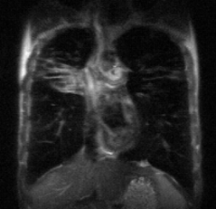
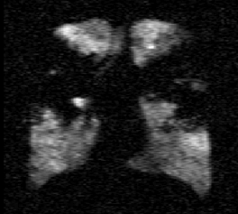
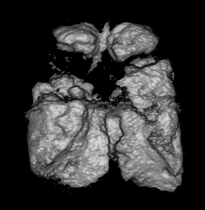

Helium MRI
Cannot image the soft tissue in the lungs with MRI
  Proton signal too low
Can use tracer gas with a magnetic signal to image ventilation distribution
  Xenon
  Helium³
Needs to be hyperpolarized to enhance the nuclear magnetic signal
  Polarized laser light at high temp to align the nuclear spins
He segmented
3
He segmented 3He volume
He MRI
3
3
He MRI
H MRI
3
1
H MRI
1
McMahon et al, Eur Radiol 2006

Slide 14
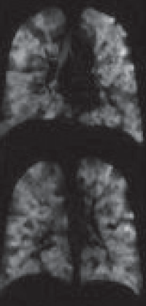
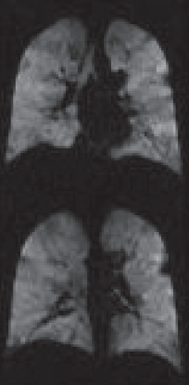
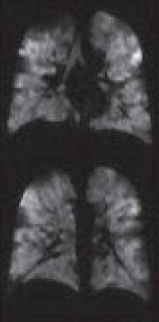
Helium MRI in CF: improvement with Ivacaftor
28d Ivacaftor
14d placebo
FEV₁ 62%
FEV₁ 83%
FEV₁ 72%
Altes et al, NACF 2012

Slide 15


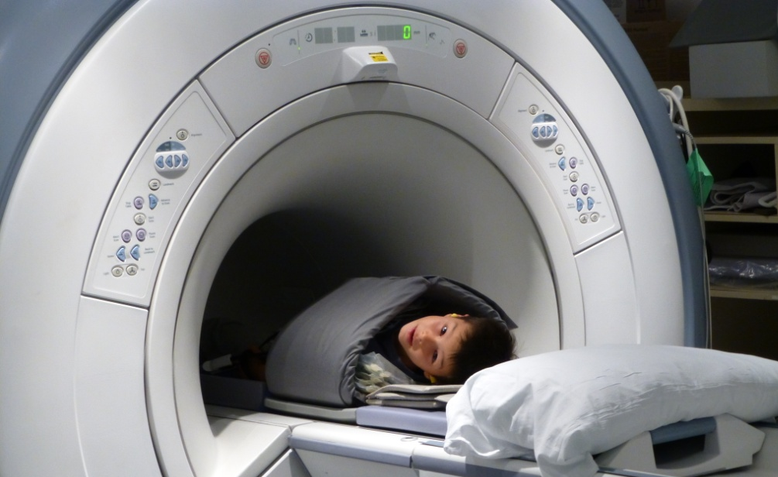
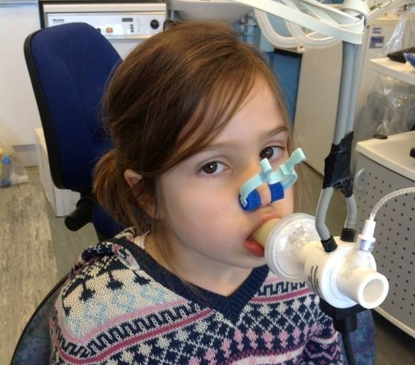
Ongoing HeMRI studies in CF
Compare LCI and HeMRI in children with CF
  Sensitivity of different methods?
  Ventilation defects in asymptomatic patients?
  Are ventilation defects localised or diffuse?
Funded by CF Trust
  20 CF patients to have MRI, LCI, CT and lung function
  10 Healthy controls: MRI, LCI, lung function
MRI
LCI

Slide 16
HeMRI appears to be more sensitive than LCI
Healthy volunteer
Patients with CF
Preliminary data so far
2 of 4 CF patients with normal LCI
All have ventilation defects on MRI
Undergoing further analysis to quantify ventilation defects and ventilation efficiency
More data to be presented at winter BTS

Slide 17
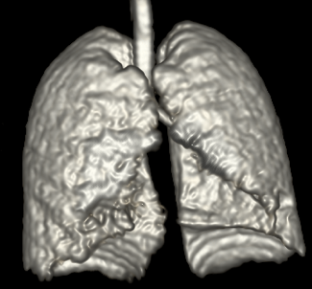
Helium MRI
Hugely powerful technique
Considerable potential as a research tool and trial endpoint
Can also perform dynamic imaging during washout
  Quantify time constant of voxels
  Produce a washout efficiency map of the lungs
  Plan to relate this to LCI
But…
Very specialised
Expensive
Hard to get hold of He³

Slide 18
Future of lung physiology in CF
Move to clinical application of MBW
  Milder patients
Adoption in clinical trials
  EMA considering LCI as primary endpoint for CF trials
  Improved technologies that are commercially available
  Improved assessment and analysis algorithms
HeMRI a powerful and exciting new method of visualising lung function in an entirely new way
  Will tell us lots about evolution and resolution of lung disease

Slide 19


Acknowledgements
NIHR
University of Manchester
Manchester Adult CF Centre
Prof Jim Wild
Dr Helen Marshall
Felix Horn
Prof Jane Davies
Dr Nicholas Bell
CF Trust

