Slide 1

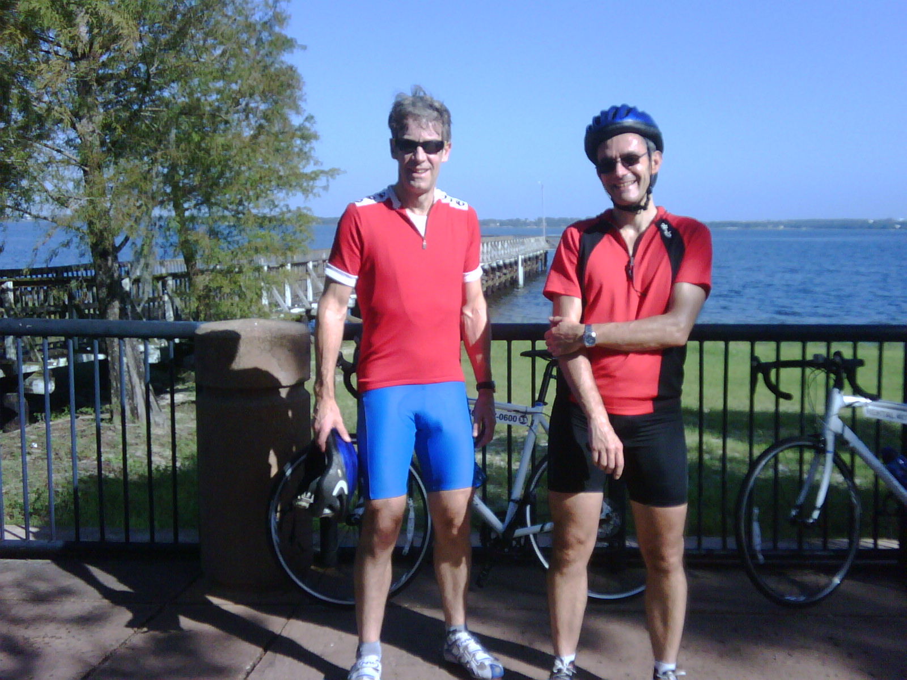


Trial of Optimal TheRapy for Pseudomonas EraDicatiOn in Cystic Fibrosis
EudraCT number: 2009-012575-10
ISRCTN number: ISRCTN02734162
Chief Investigator:
Dr Simon Langton Hewer
Co-Investigator:
Prof Alan Smyth
Trial Co-ordinator:
Hannah Short

Slide 2
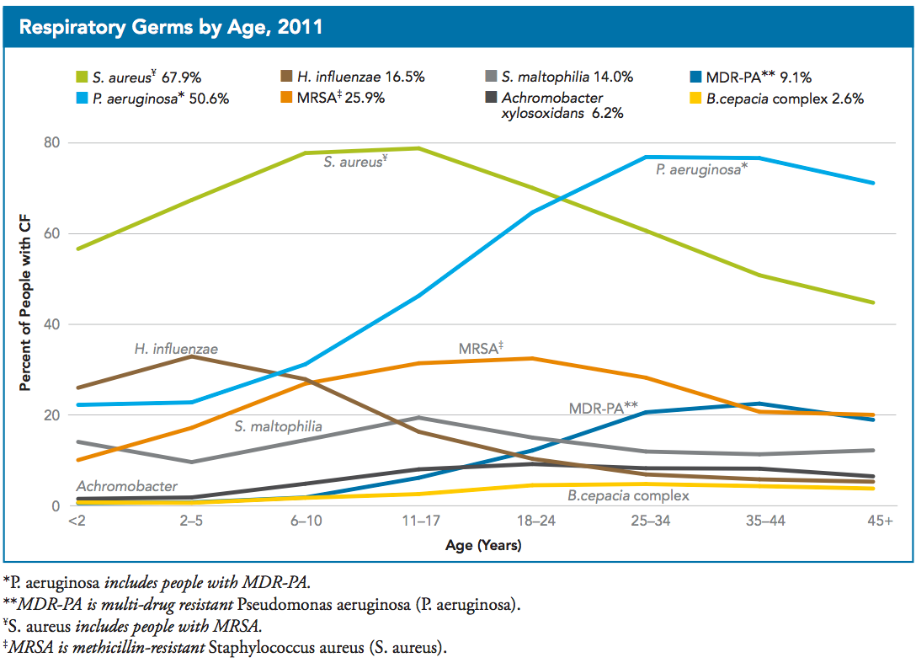

Slide 3
Natural history of acquisition of Pseudomonas aeruginosa
Mucoid PA, development of biofilm
Second PA culture
Birth
Persistent PA infection
First PA culture
PA free interval
Intermittent infection
Chronic infection
Adapted from Rosenfeld NACFC, Minneapolis 2009

Slide 4
Consequences of infection with Pseudomonas aeruginosa
Reduced FEV₁ during childhood
Faster decline in FEV₁
More rapid decline in CXR score
Reduced growth, QoL
Increased hospitalisation and need for antibiotics
Reduced adult survival
Impossible to eradicate once chronic infection is established

Slide 5

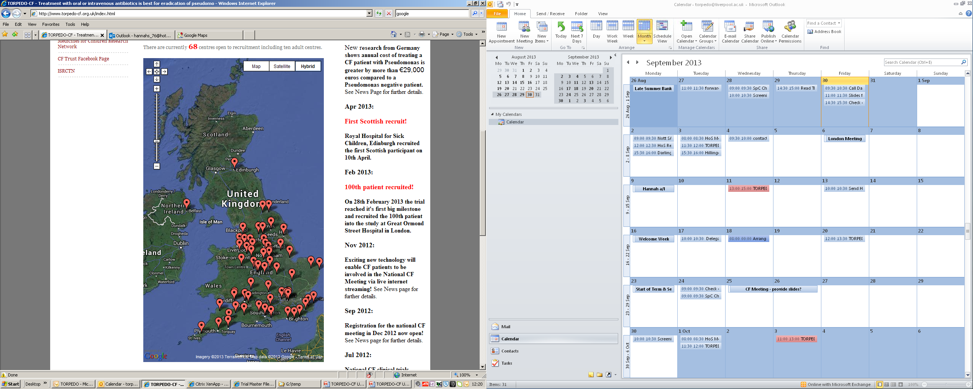
Study Update – Sites
First site opened to recruitment in June 2010.
There are now 68 sites in the UK open to recruitment
of which 58 are paediatric sites.

Slide 6
Study Update – Recruitment
Since October 2010 we have recruited a total of 132 patients.
Our next key target is to recruit 200 patients by the end of May 2014.
If we achieve this milestone the study team will request an extension to the recruitment period to enable us to reach our original target of 280.

Slide 7
Study Update – Recruitment

Slide 8
Study Update – Recruitment at Sites

Slide 9
Study Update – Screening
and Recruitment
The original feasibility study predicted that approximately 45% of eligible patients would agree to take part in the trial.
The latest screening data shows that approximately 40% of eligible patients have consented to take part in the trial.
The screening data shows that the main reasons given for non-consent of eligible patients have been patient preference for either IV or oral antibiotic treatment.

Slide 10
Recruitment issues
Issues with Recruitment
  Team Approach to TORPEDO trial
  Determination to reach target of 280 recruits
  Likely to be achieved if every eligible patient is approached by senior member of CF team
    CF teams will need resources for this – MCRN, CLRN
  Helpful where these eligible patients are already aware of the study and the CF team is enthusiastic about their participation and the importance of their involvement in answering the question of IV superiority over oral therapy
  Having come this far we need to achieve the target!
  Avoidance of ‘Trial fatigue’

Slide 11
Recruitment issues
Competing studies
Availability of beds
Duration of trial treatment
Patient preference
Other issues?

Slide 12
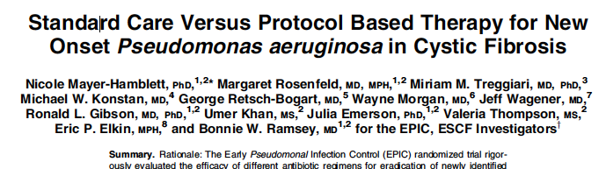

Recruitment issues
Competing studies
Availability of beds
Duration of trial treatment
Patient preference
Other issues?
Pa recurrence occurred in 104/298 (35%) trial participants and in 295/549 (54%) historical controls over 15m

Slide 13
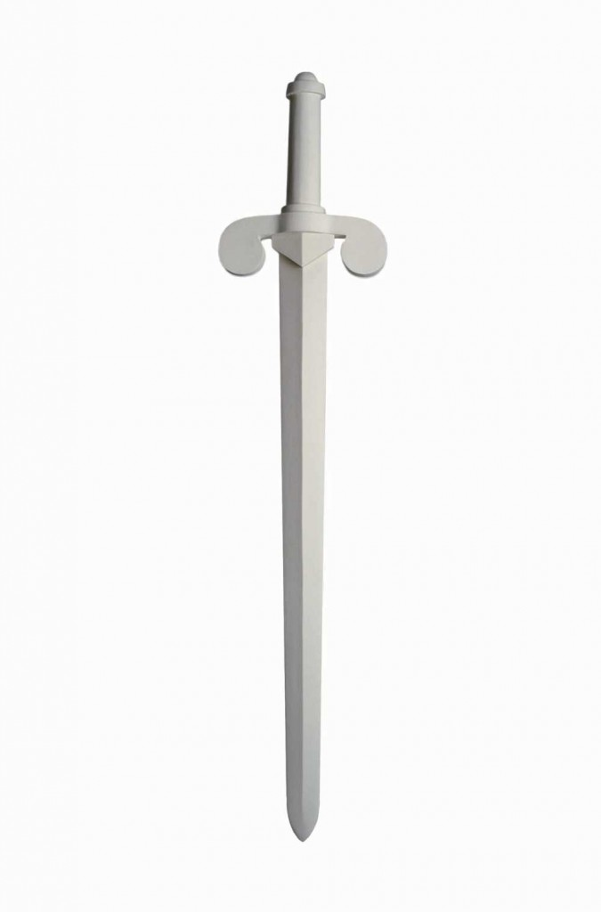
Recruitment issues
Competing studies
Availability of beds
Duration of trial treatment
Patient preference
Other issues?

Slide 14

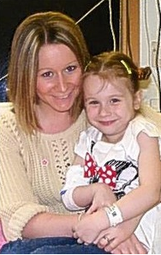
“We decided to take part in the trial because we want to help improve the care for cystic fibrosis patients. As a nurse, part of my job is to provide best evidence practice and without research being carried out you haven't got that evidence.”

Slide 15
And finally……….
A big thank you for all your support with the study!
Every recruit counts so if there is anything we can do to help please don’t hesitate to contact us.
Clinical Trials Unit Contact Details:
Trial Co-ordinator: Hannah Short
Telephone: 0151 282 4714
Email: torpedo@liverpool.ac.uk
Website: www.torpedo-cf.org.uk

Slide 16
Acknowledgements:
Trial Management Group (TMG)
Dr Simon Langton Hewer Chief Investigator
Dr Alan Smyth Co-Investigator
Professor Rachel Elliott Lead Health Economist
Professor Deborah Ashby Lead Statistician
Mr Ashley Jones Senior Trial Statistician
Miss Michaela Blundell Statistician
Helen Hickey Senior Trial Manager
Hannah Smith Trial Coordinator
Trial Steering Committee (TSC)
Professor Jonathan Grigg Independent Chairperson
Dr Ranjit Lall Independent Statistician
Miss Sophie Lewis Independent Layperson
Independent Data and Safety Monitoring Committee (IDSMC)
Dr Bob Dinwiddie Chairman, Paediatric Respiratory Physician
Prof Christiane De Boeck Respiratory Physician
Mrs Enid Hennessy Expert in Statistics
http://www.torpedo-cf.org.uk

