Slide 1
UK Cystic Fibrosis Registry Annual Data Report 2018
Full report can be found at cysticfibrosis.org.uk/registryreports

Slide 2
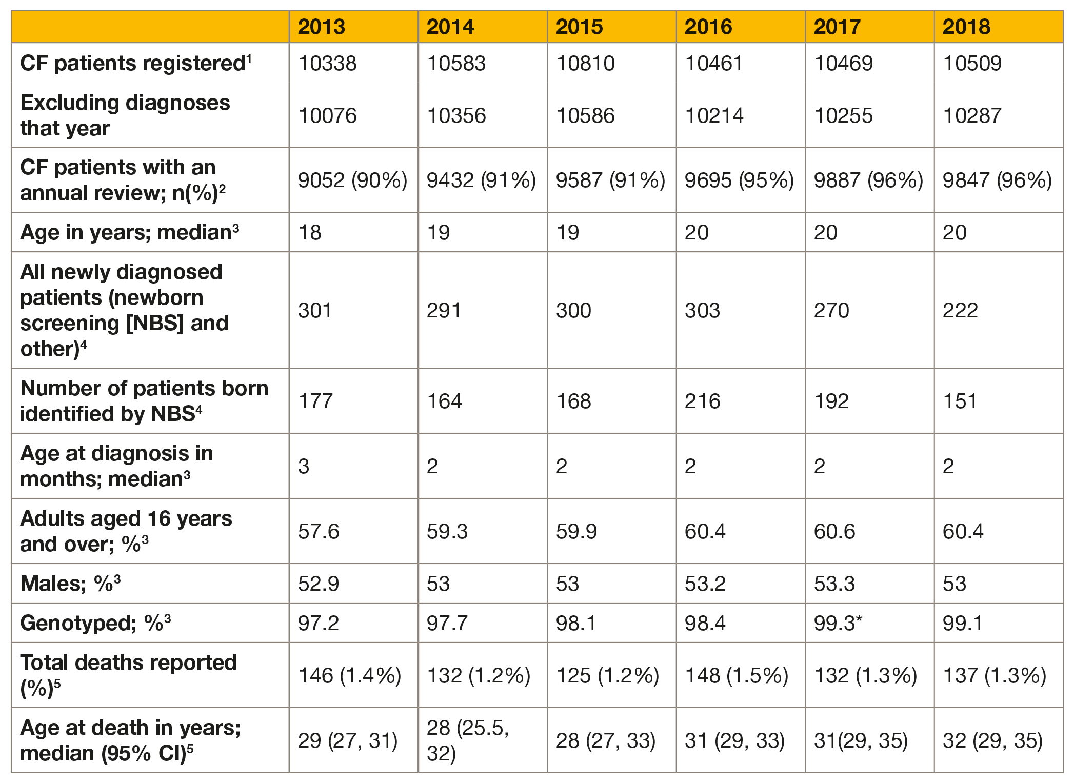
1.1 Summary of the UK Cystic Fibrosis Registry

Slide 3
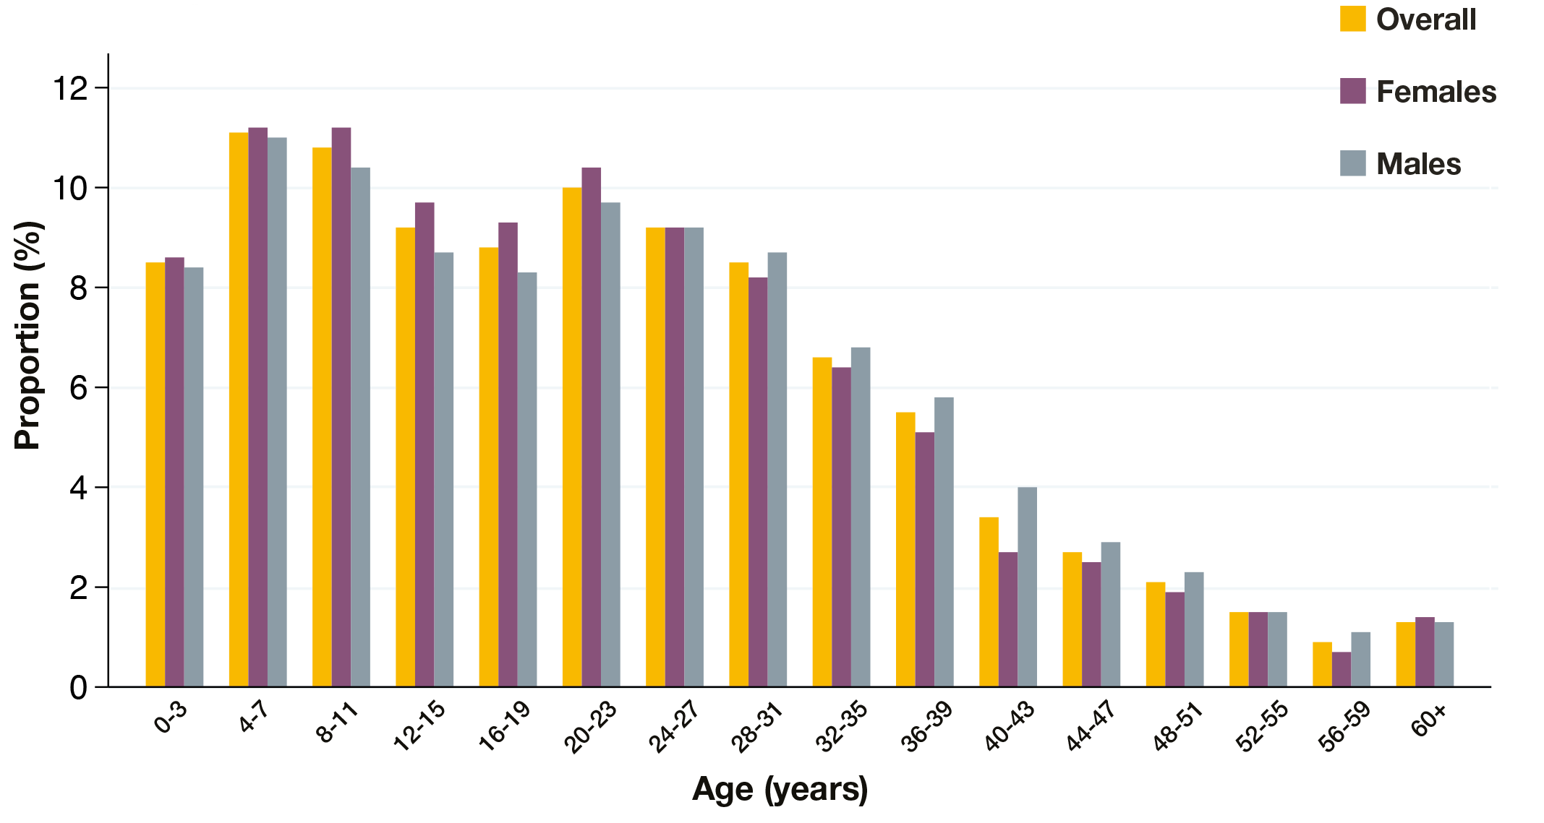
1.2 Age distribution by sex N=9847

Slide 4
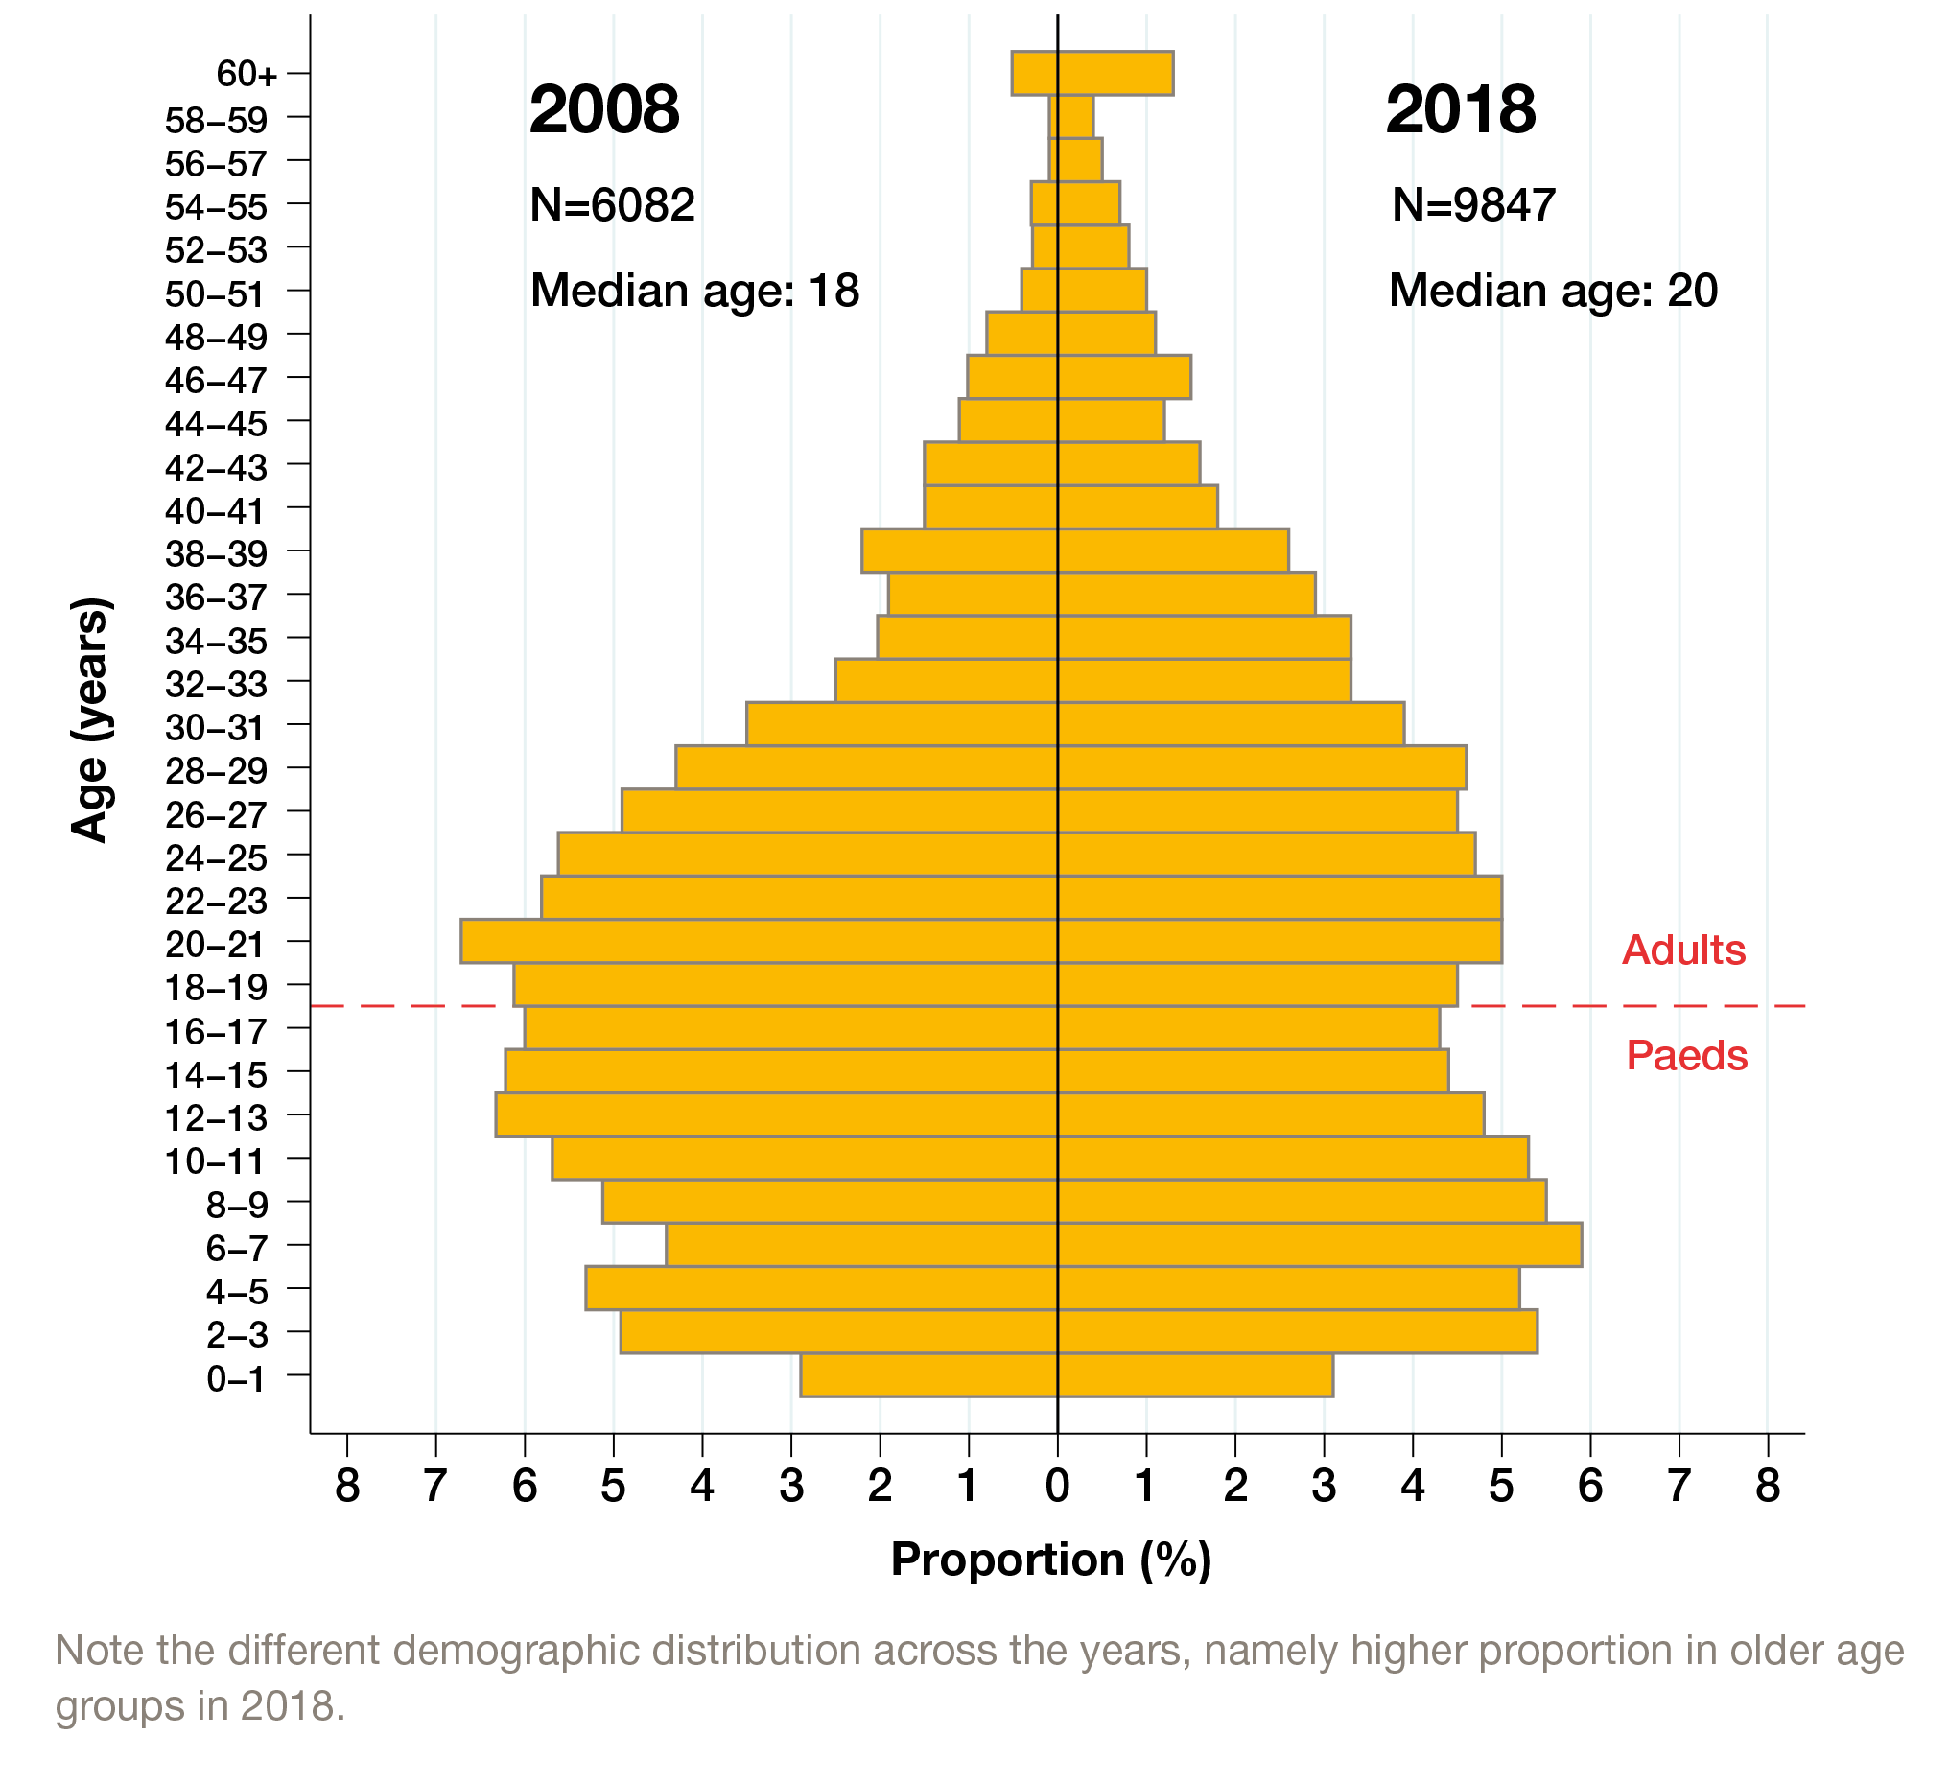
1.3 Age distribution of the UK CF population in 2008 vs 2018

Slide 5
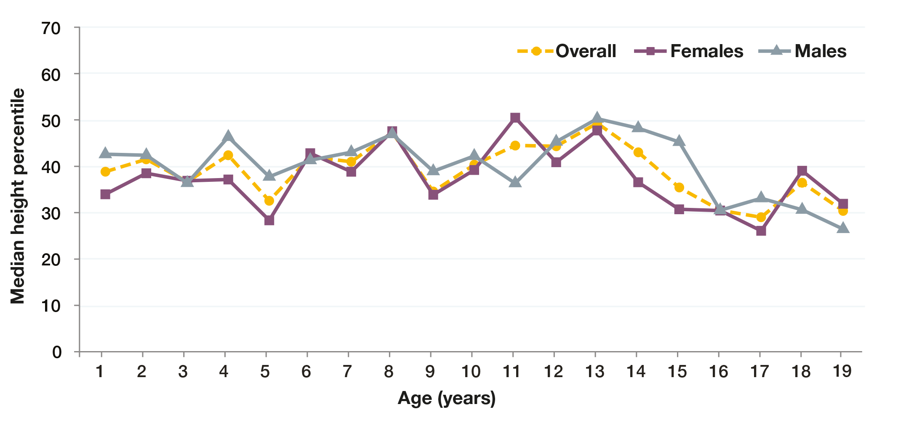
1.4 Height percentiles of children and young people (<20 years) N=4760

Slide 6
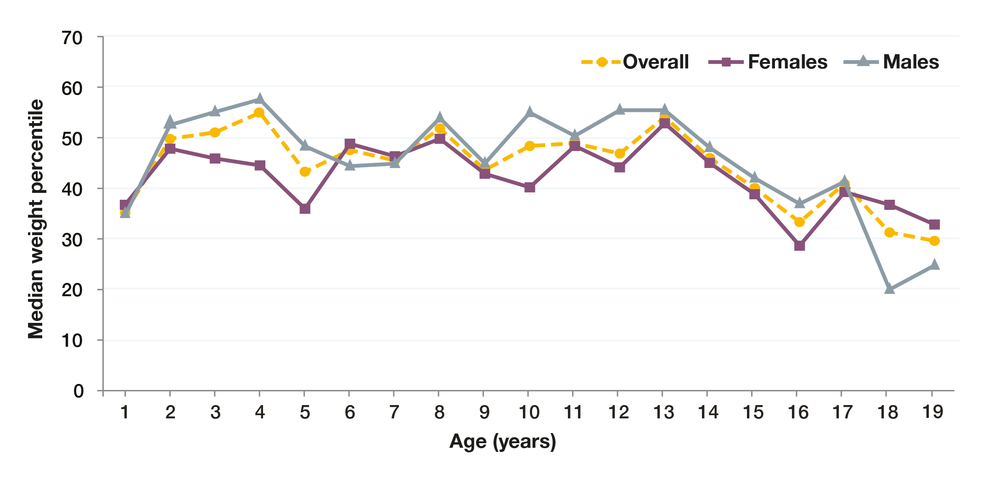
1.5 Weight percentiles of children and young people (<20 years) N=4760

Slide 7
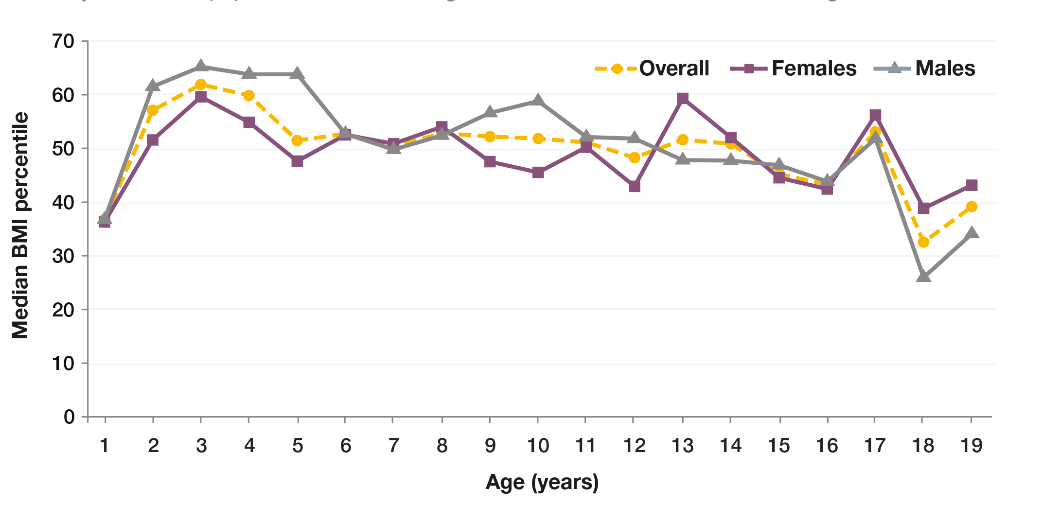
1.6 Body Mass Index (BMI) percentiles in children and young people (<20 years) N=4760

Slide 8
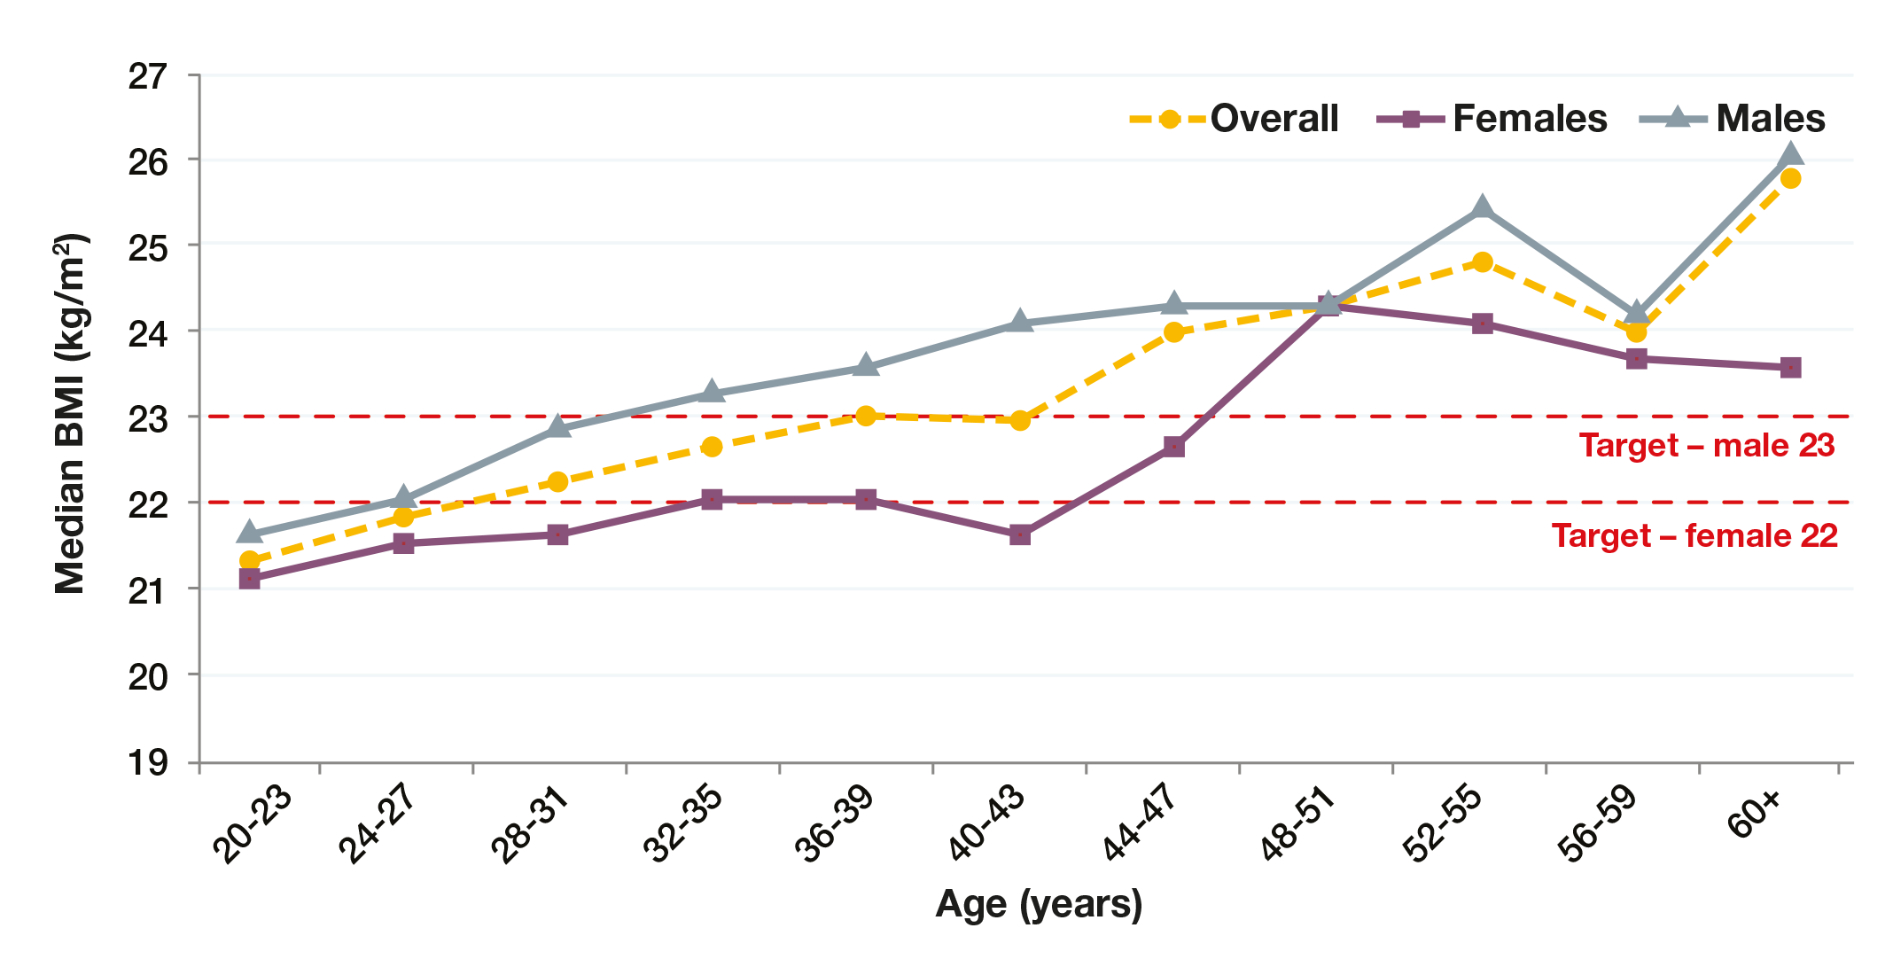
1.7 Body Mass Index (BMI) in adults (20 years and over) N=5087

Slide 9
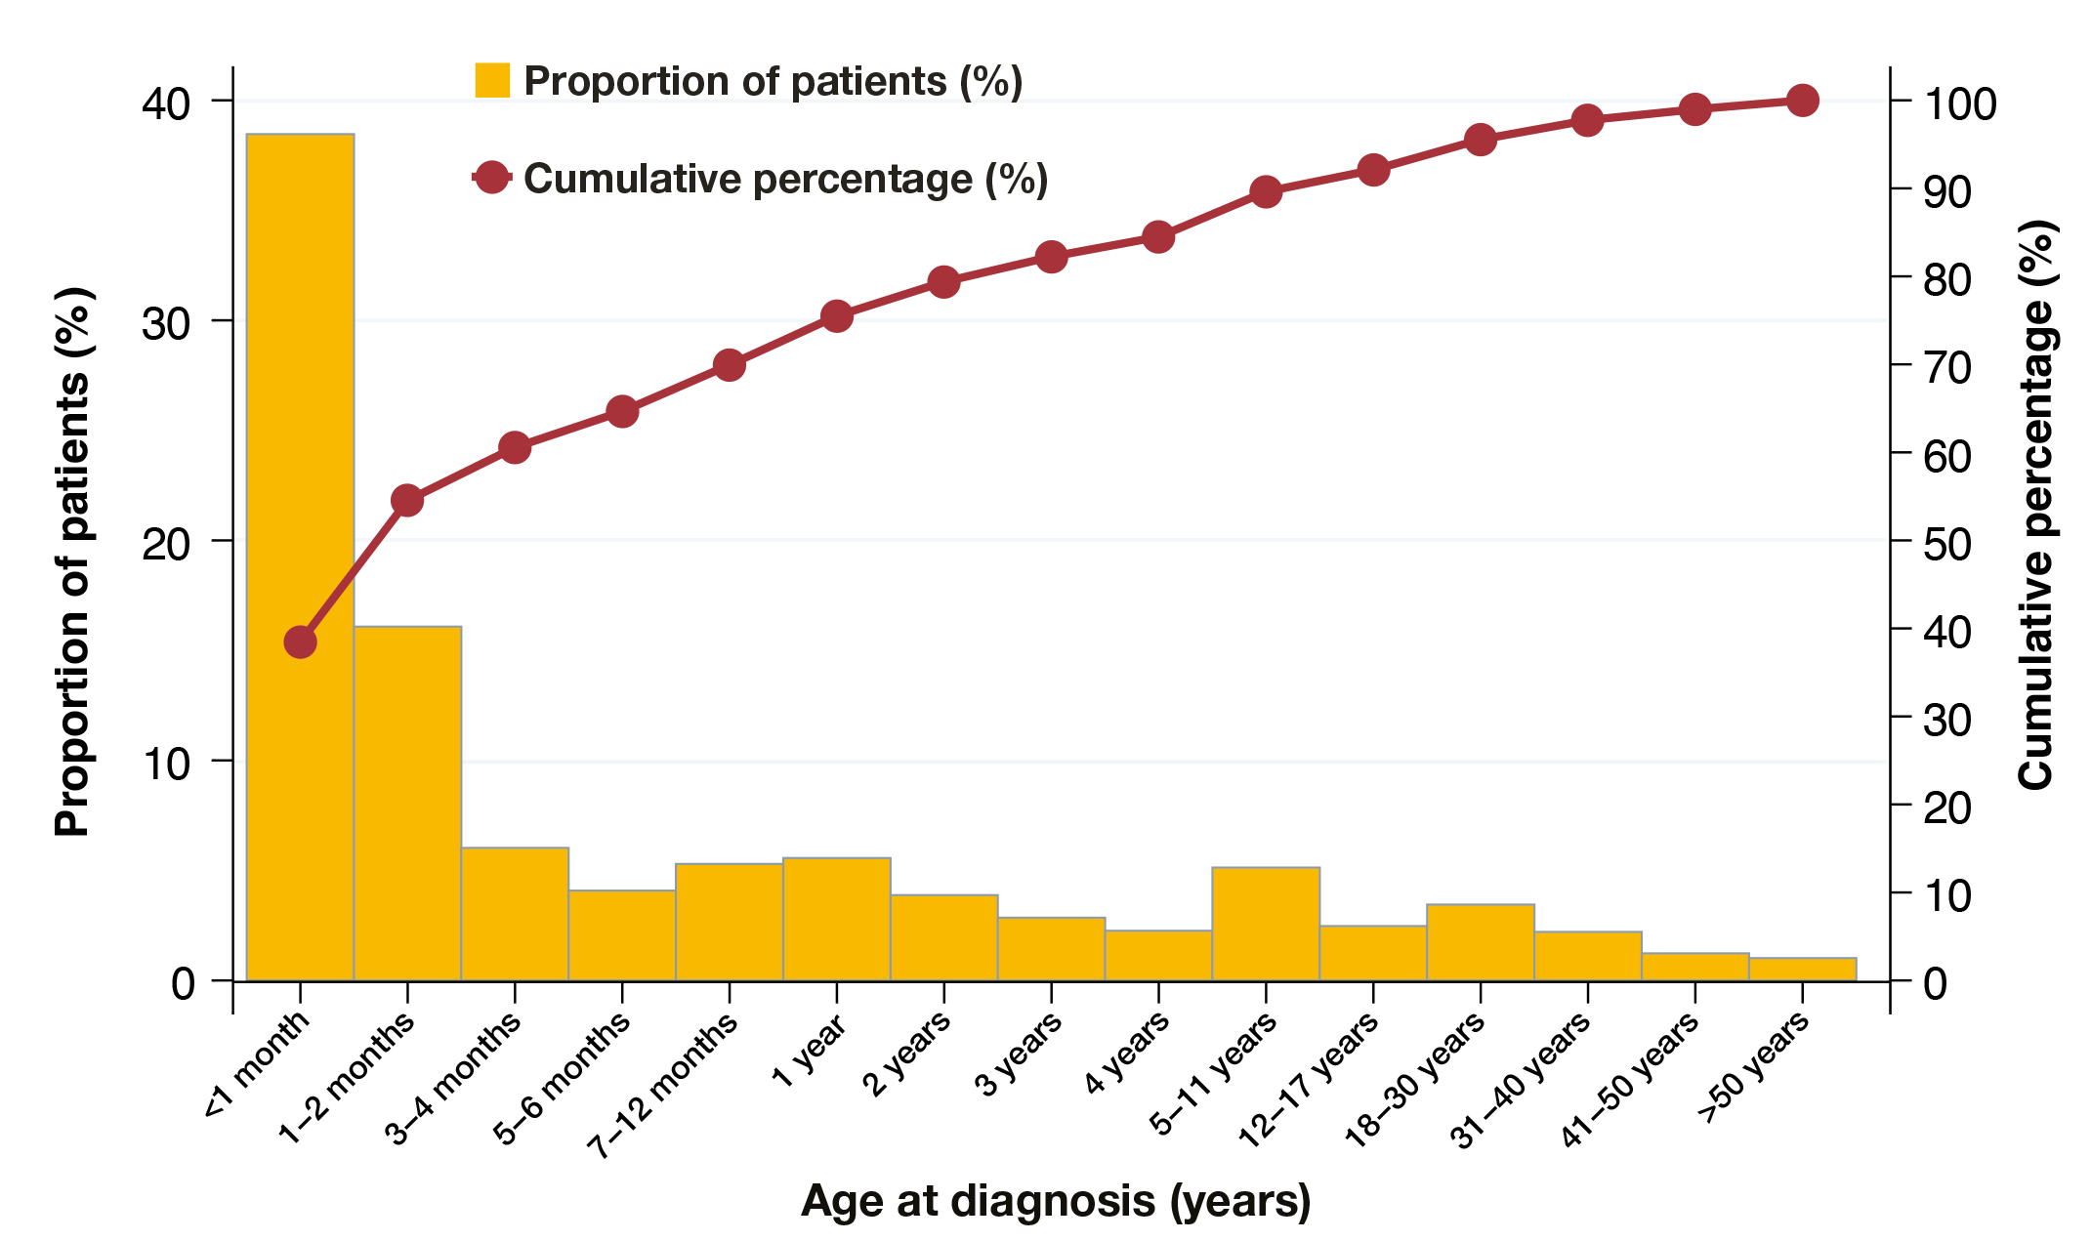
1.10 Age at diagnosis in 2018 N=9847

Slide 10
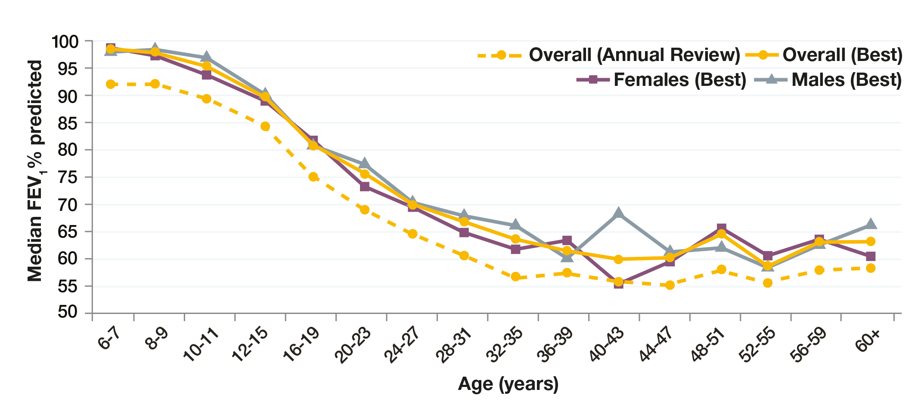
1.13 Best FEV1% predicted (GLI equations) in patients aged 6 years and older who have not had a lung transplant N=8171

Slide 11
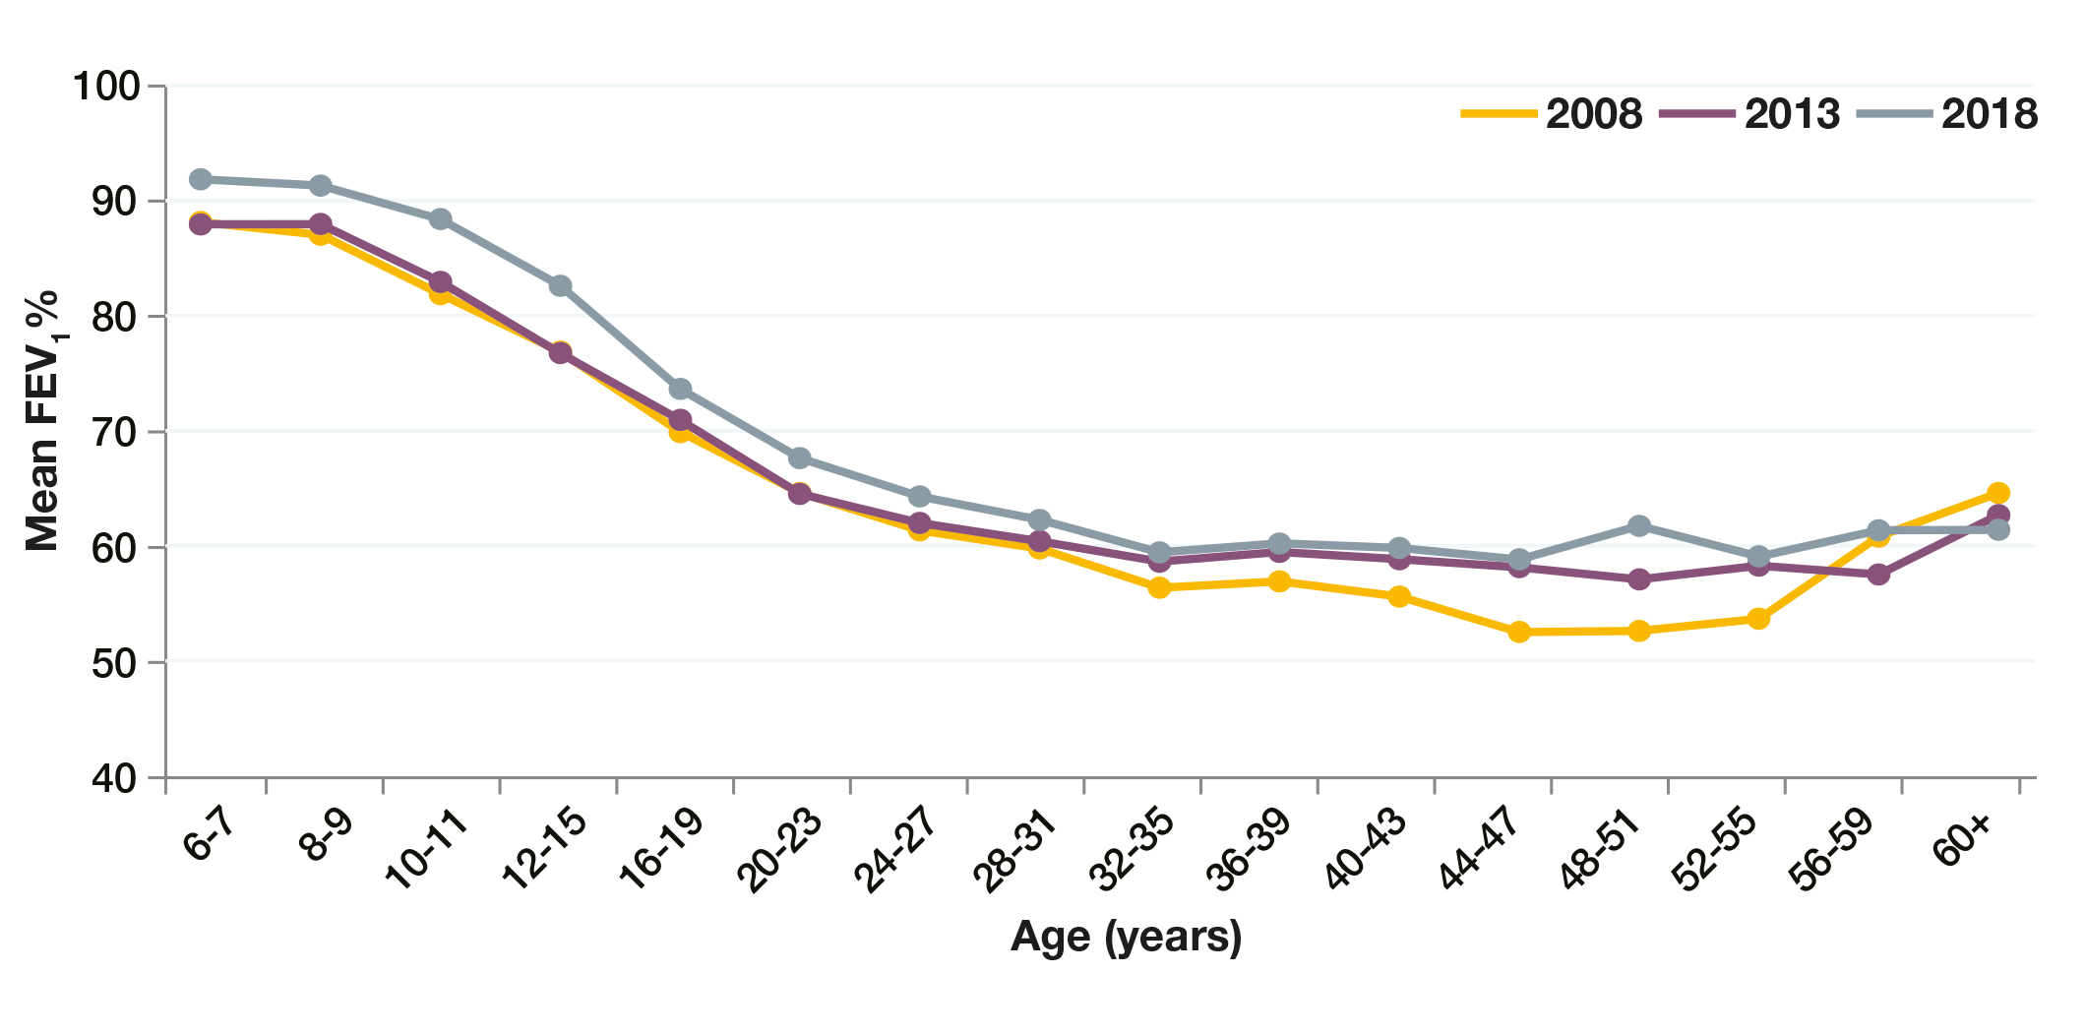
1.14 FEV1% predicted (GLI equations) over time in patients 6 years and older who have not had a lung transplant N=8171 in 2018, N=7268 in 2013, N=5049 in 2008*

Slide 12
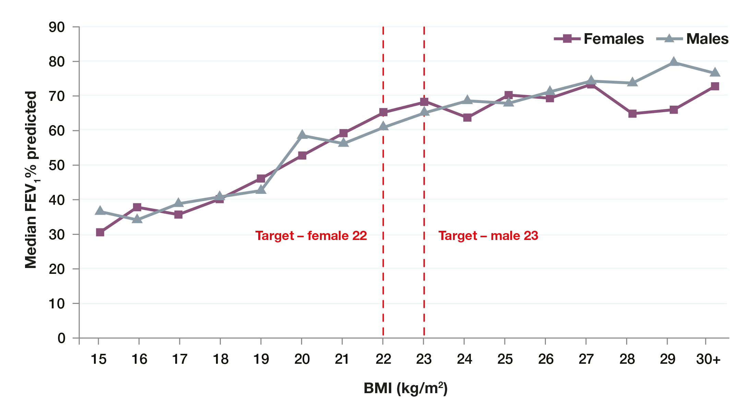
1.15 FEV1% predicted (GLI equations) and BMI in people aged 20 years and over who have not had a lung transplant N=4773*

Slide 13
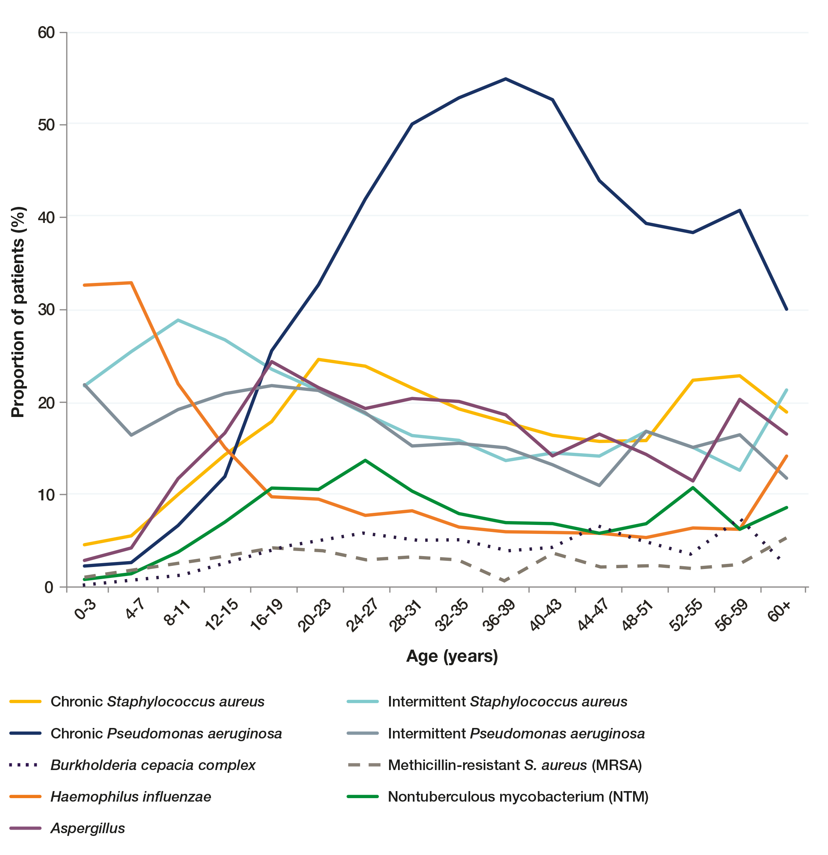
1.16 Lung infections in 2018 N=9847

Slide 14
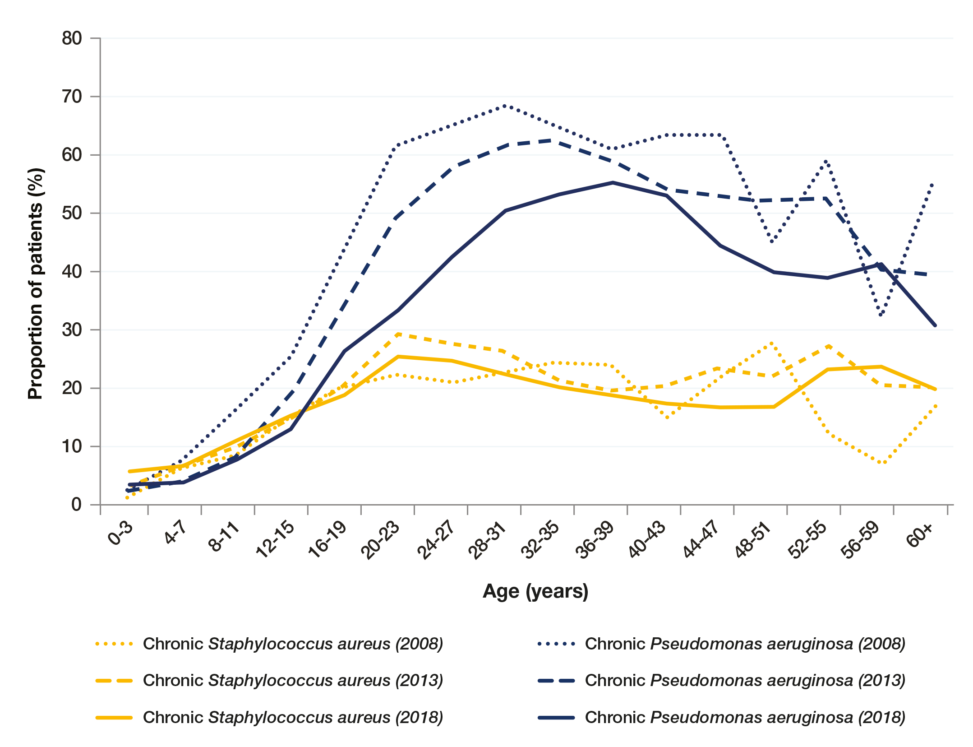
1.19 Lung infections over time N=6082 in 2008, N=9052 in 2013, N=9847 in 2018

Slide 15
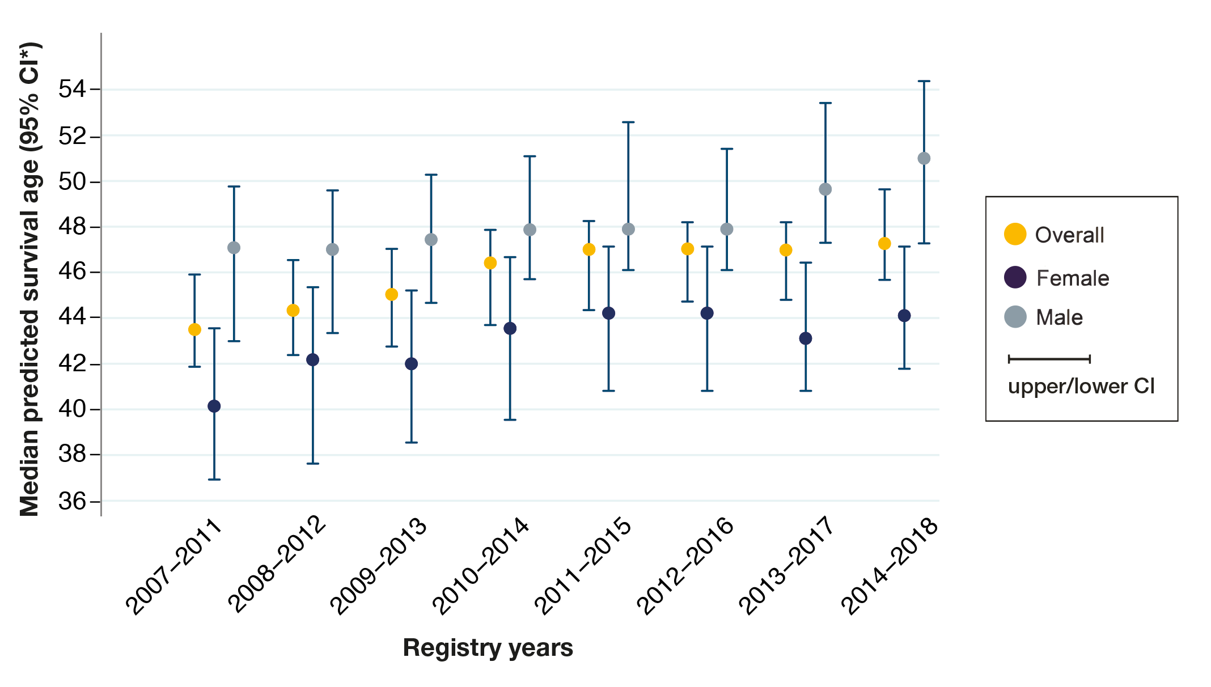
1.36 Median predicted survival age

Slide 16
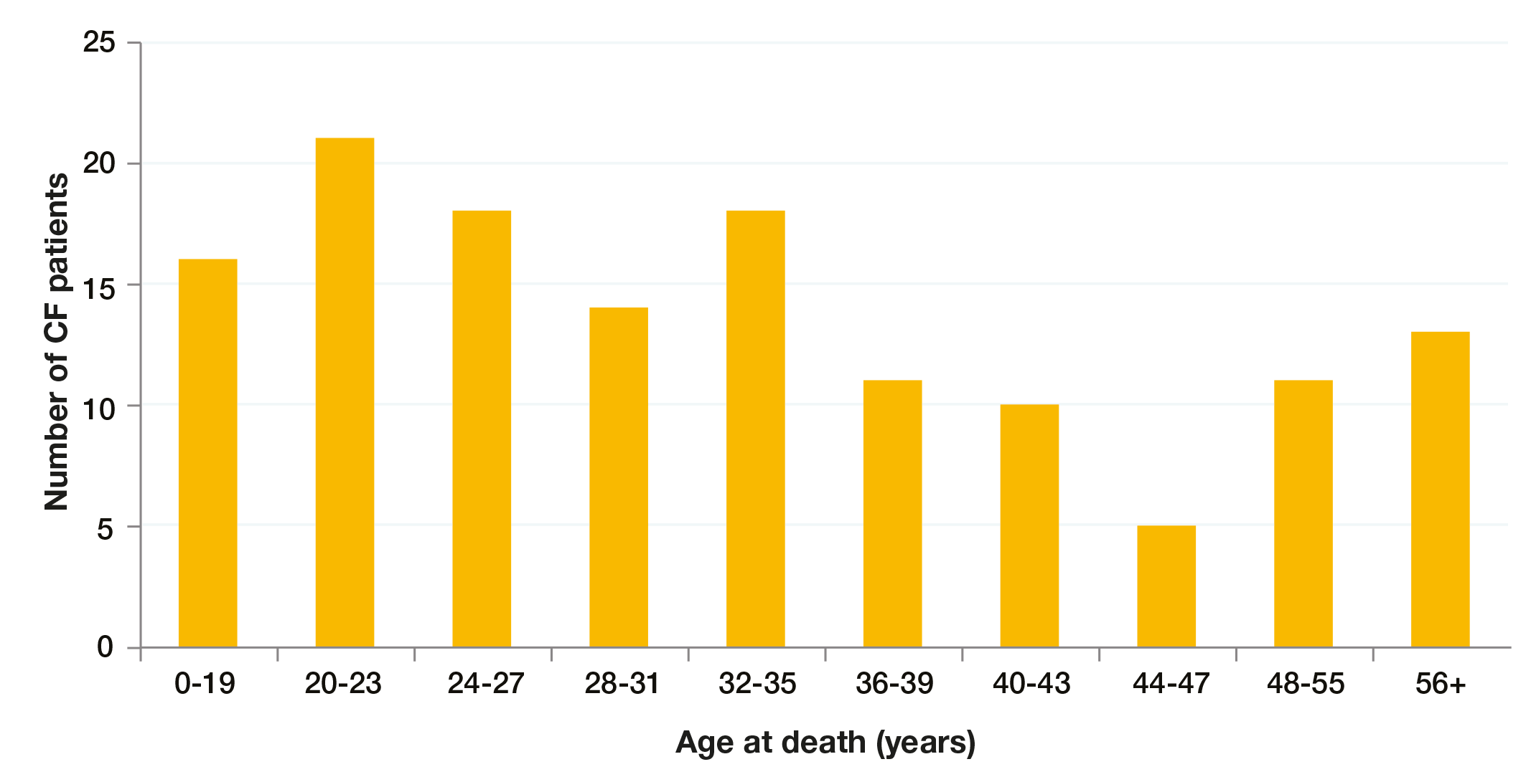
1.37 Age distribution of deaths in 2018

Slide 17
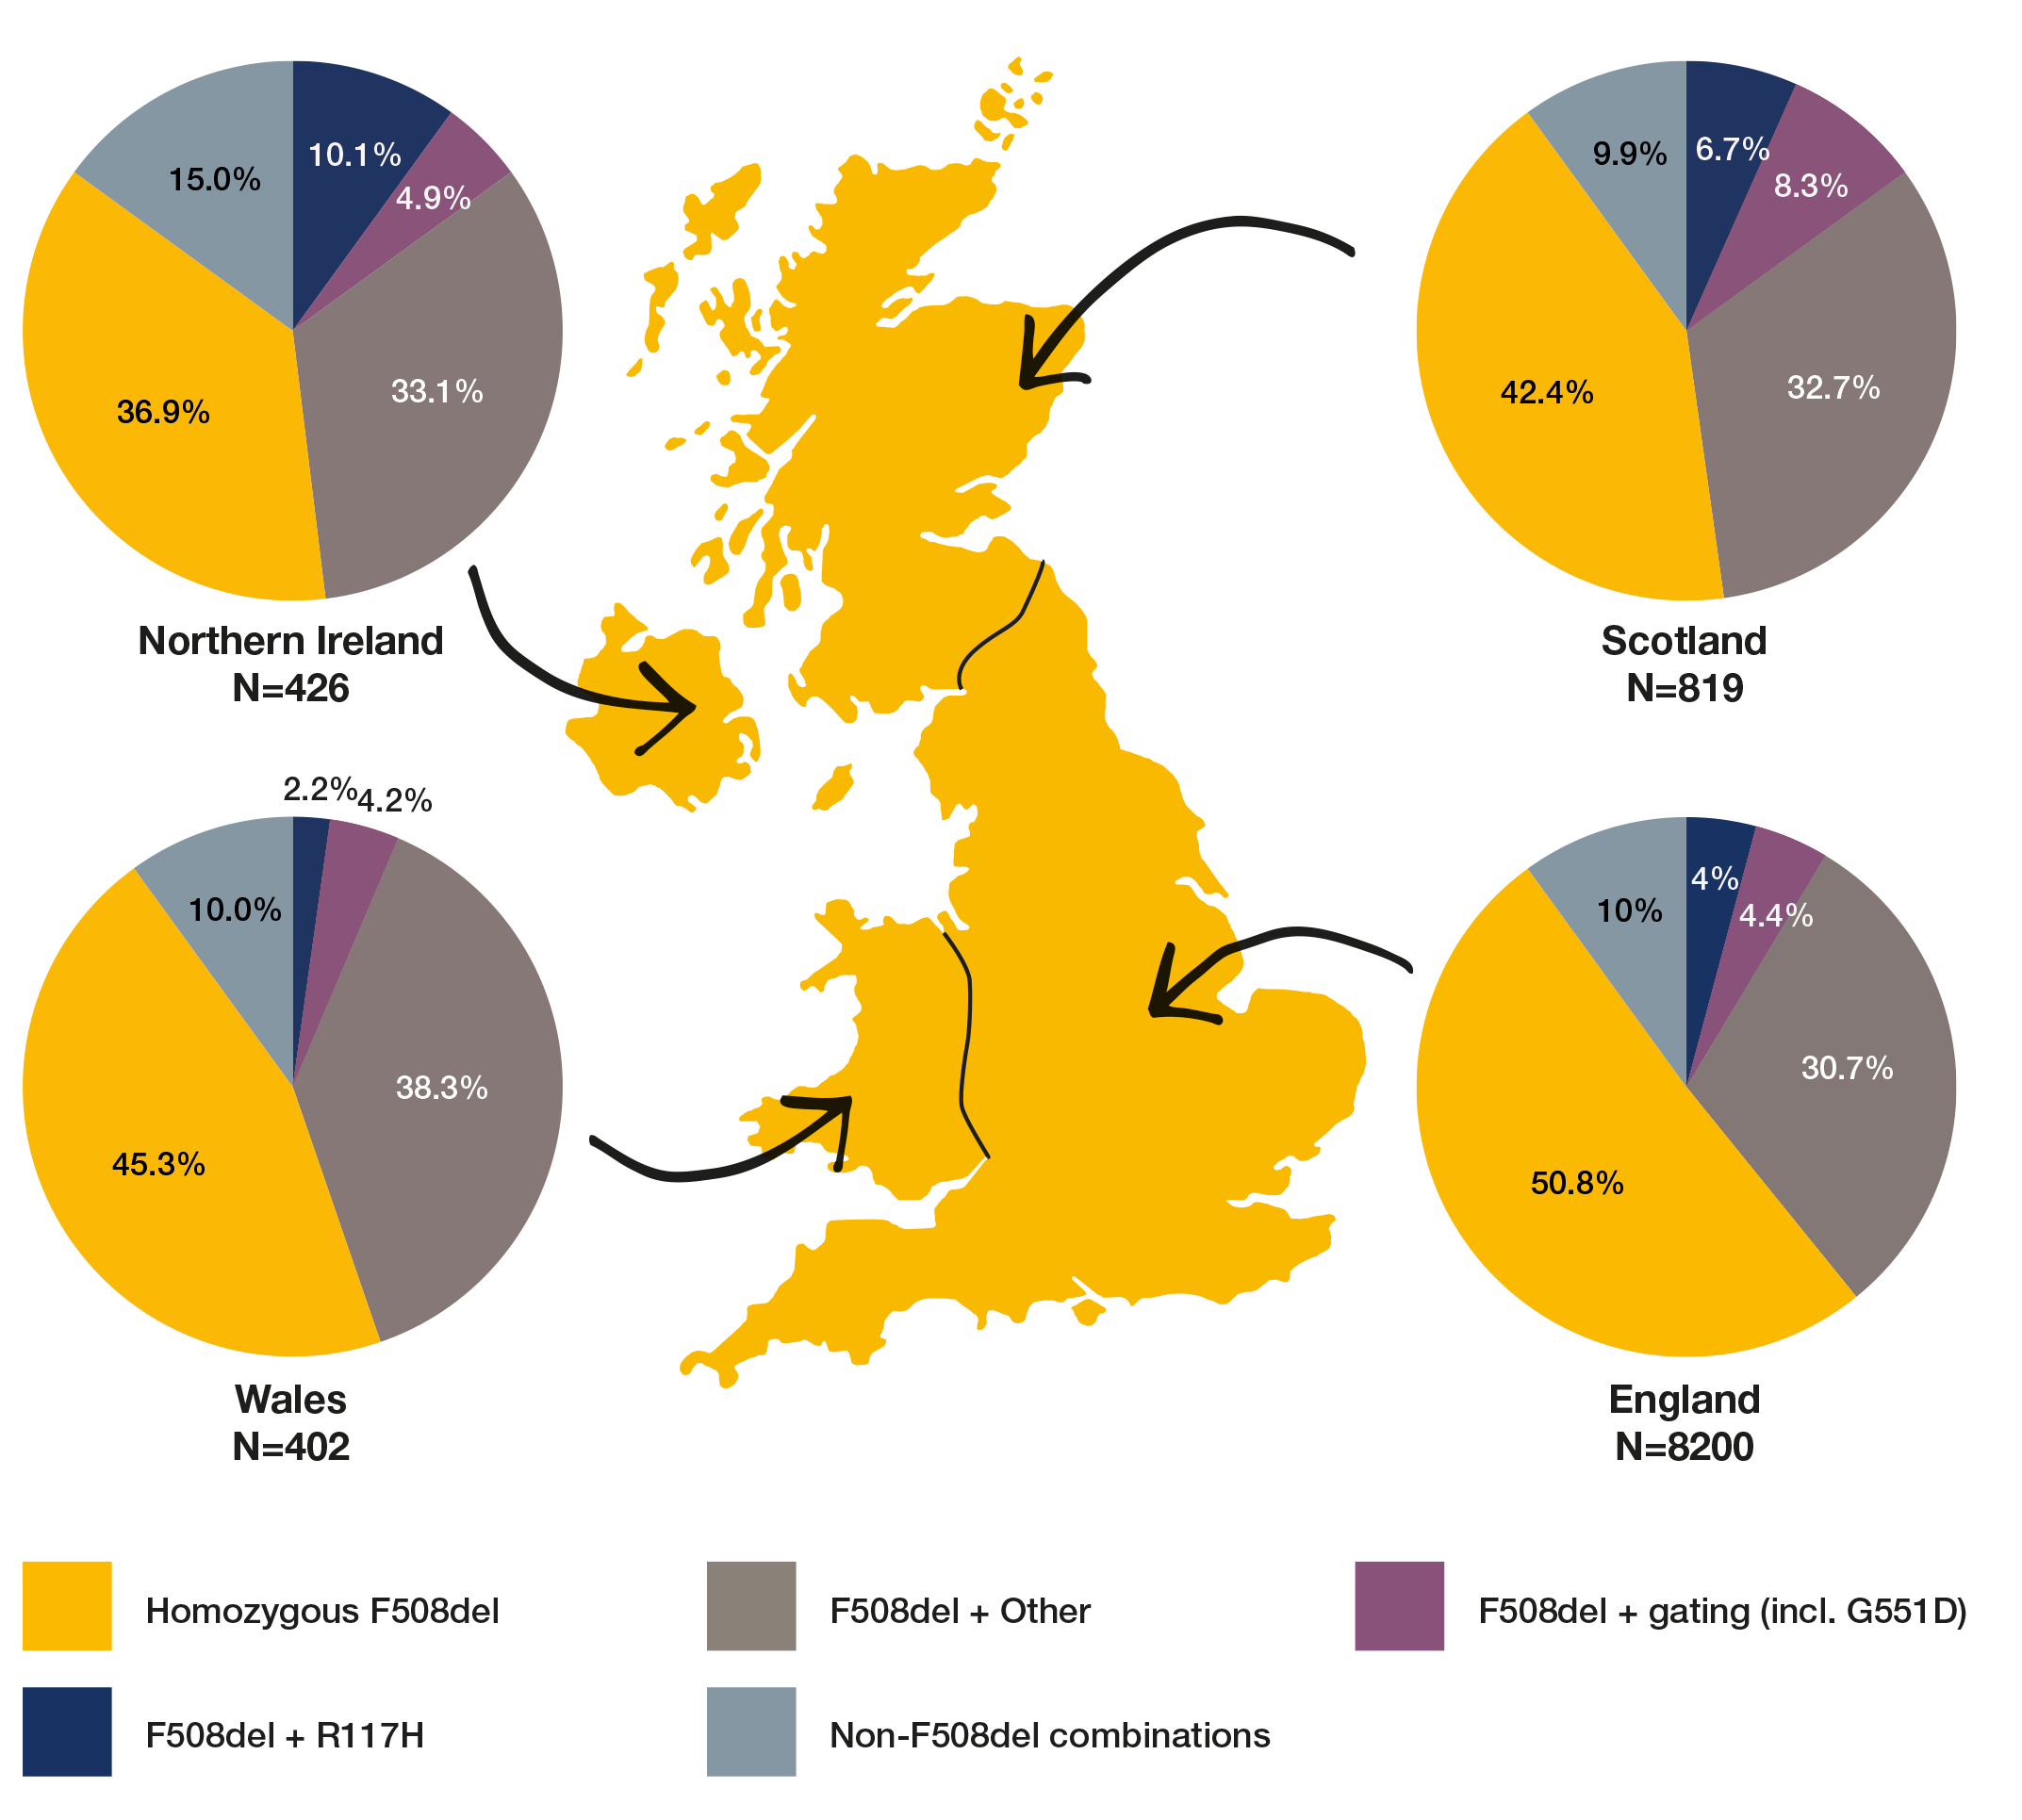
1.42 Genotype prevalence by devolved nation

