Slide 1
UK Cystic Fibrosis Registry
Annual Data Report 2017
Full report can be found at cysticfibrosis.org.uk/registryreports

Slide 2
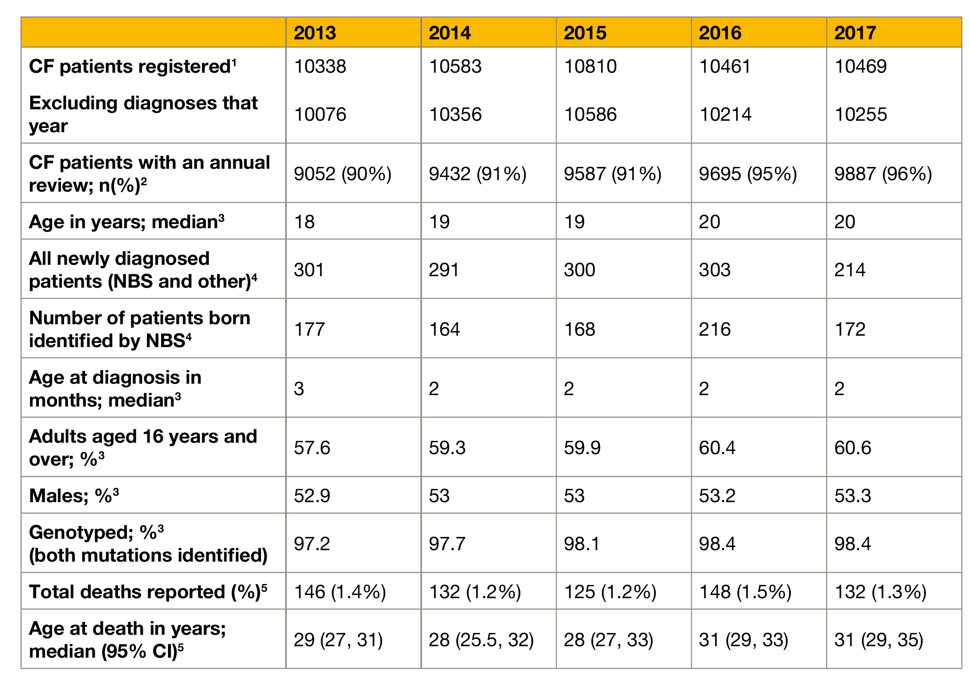
1.1 Summary of the UK Cystic Fibrosis Registry

Slide 3
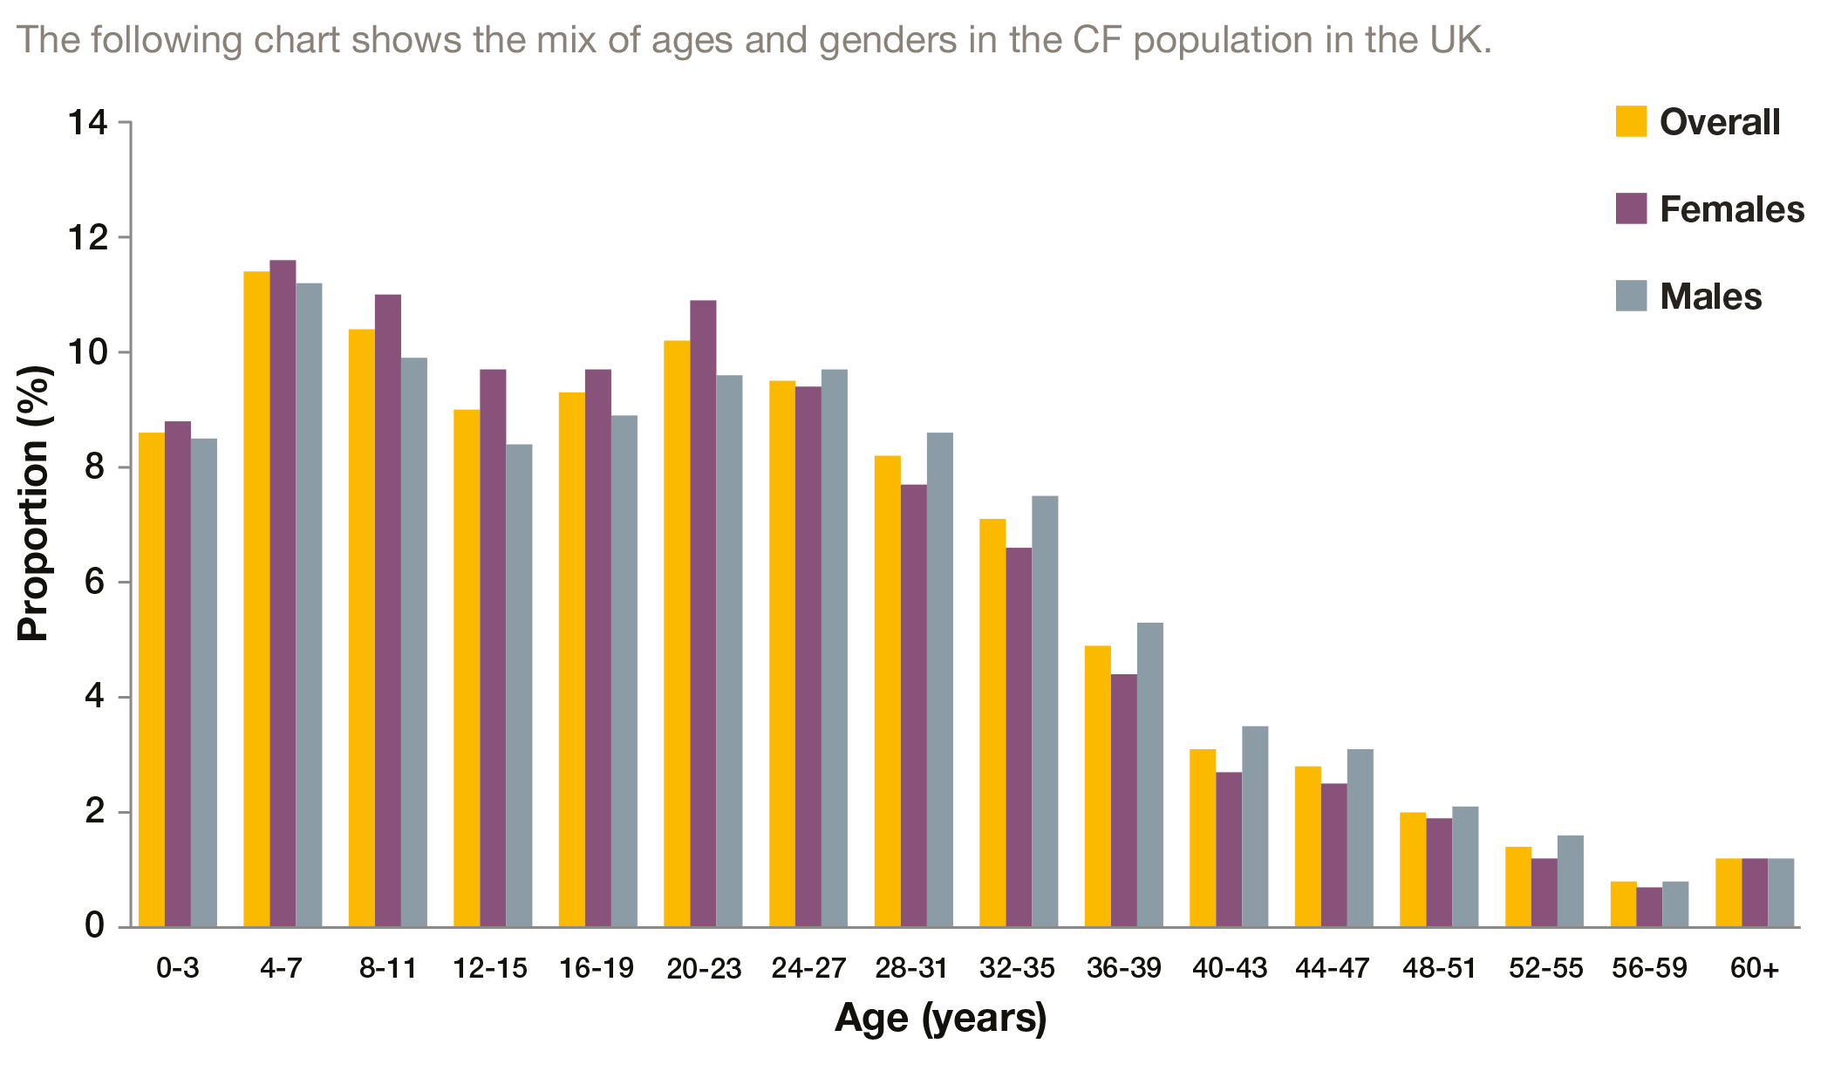
1.2 Age distribution by gender N=9887

Slide 4
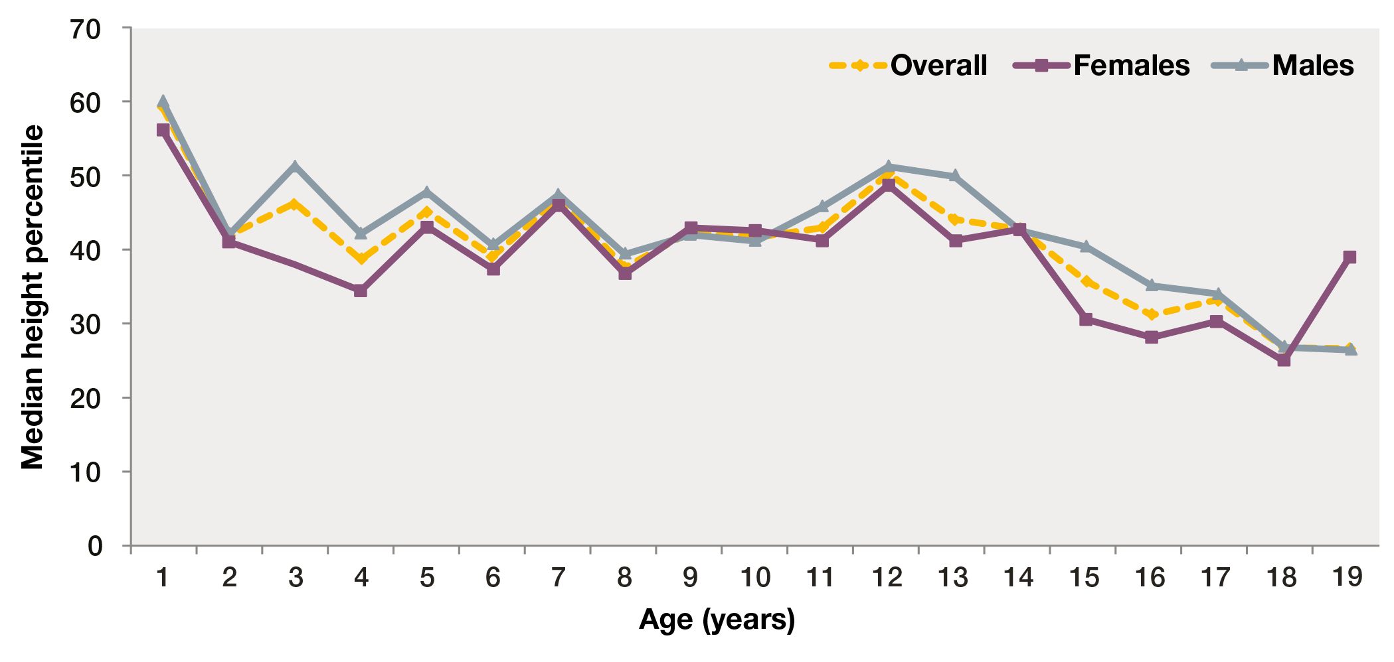
1.3 Height percentiles of children and young people (<20 years) N=4730

Slide 5
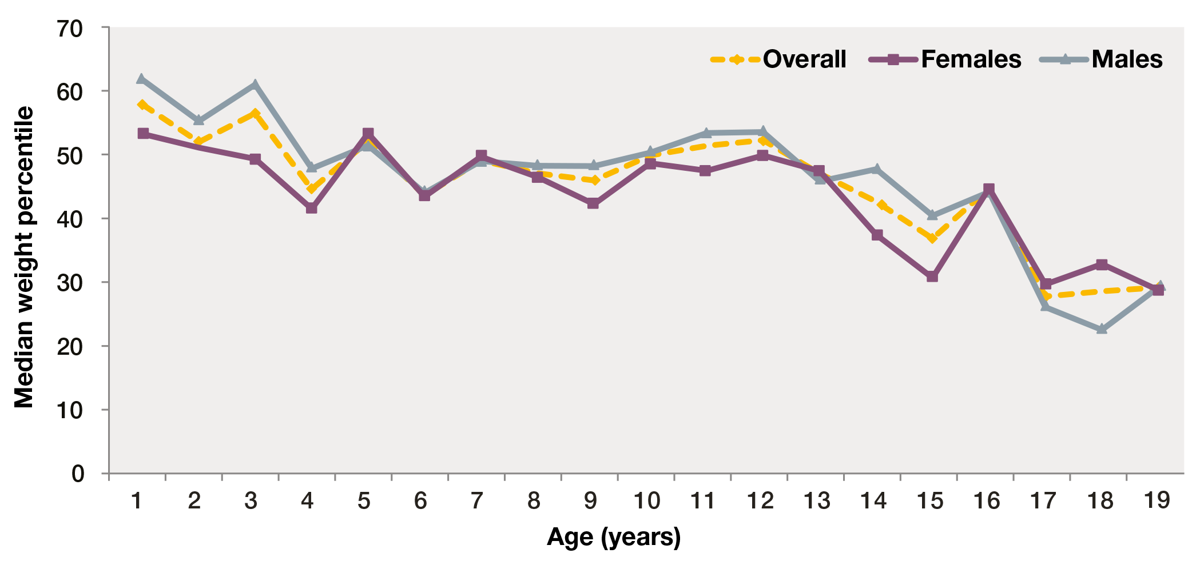
1.4 Weight percentiles of children and young people (<20 years) N=4730

Slide 6
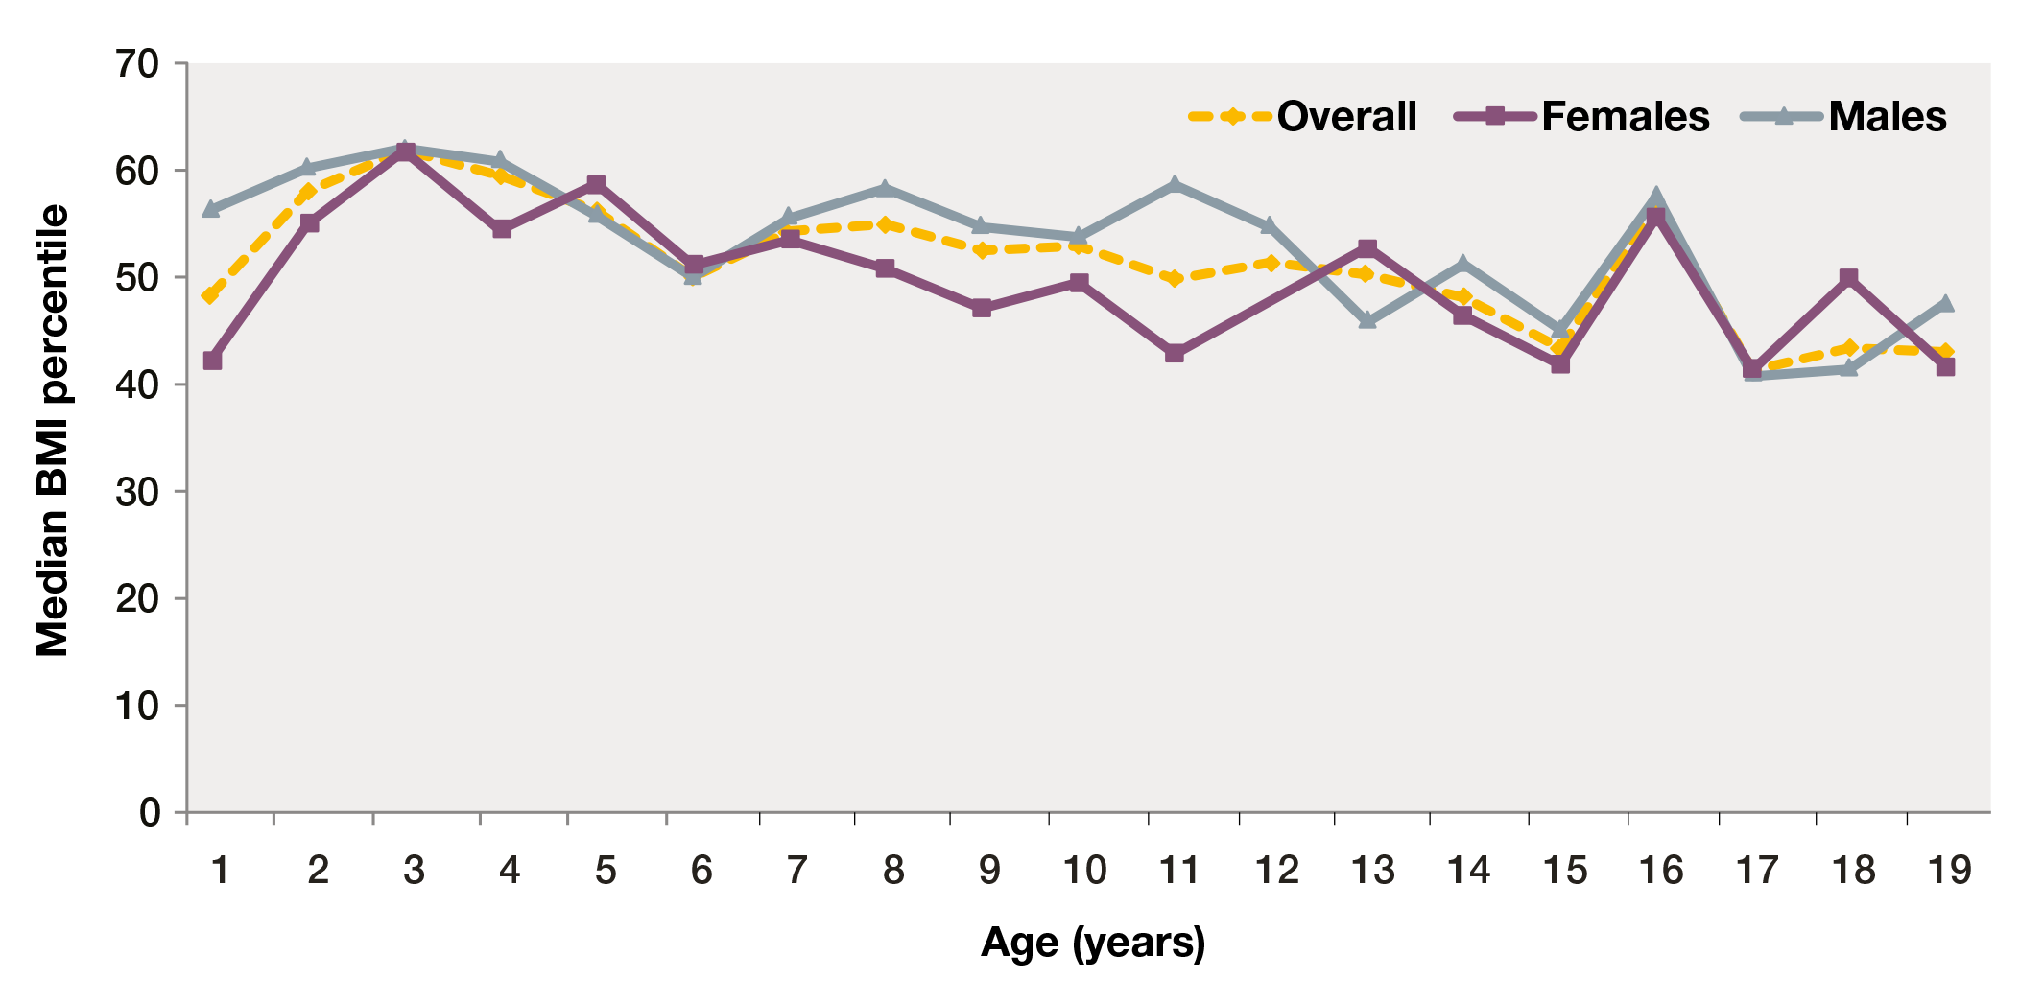
1.5 Body Mass Index (BMI) percentiles in children and young people (<20 years) N=4730

Slide 7
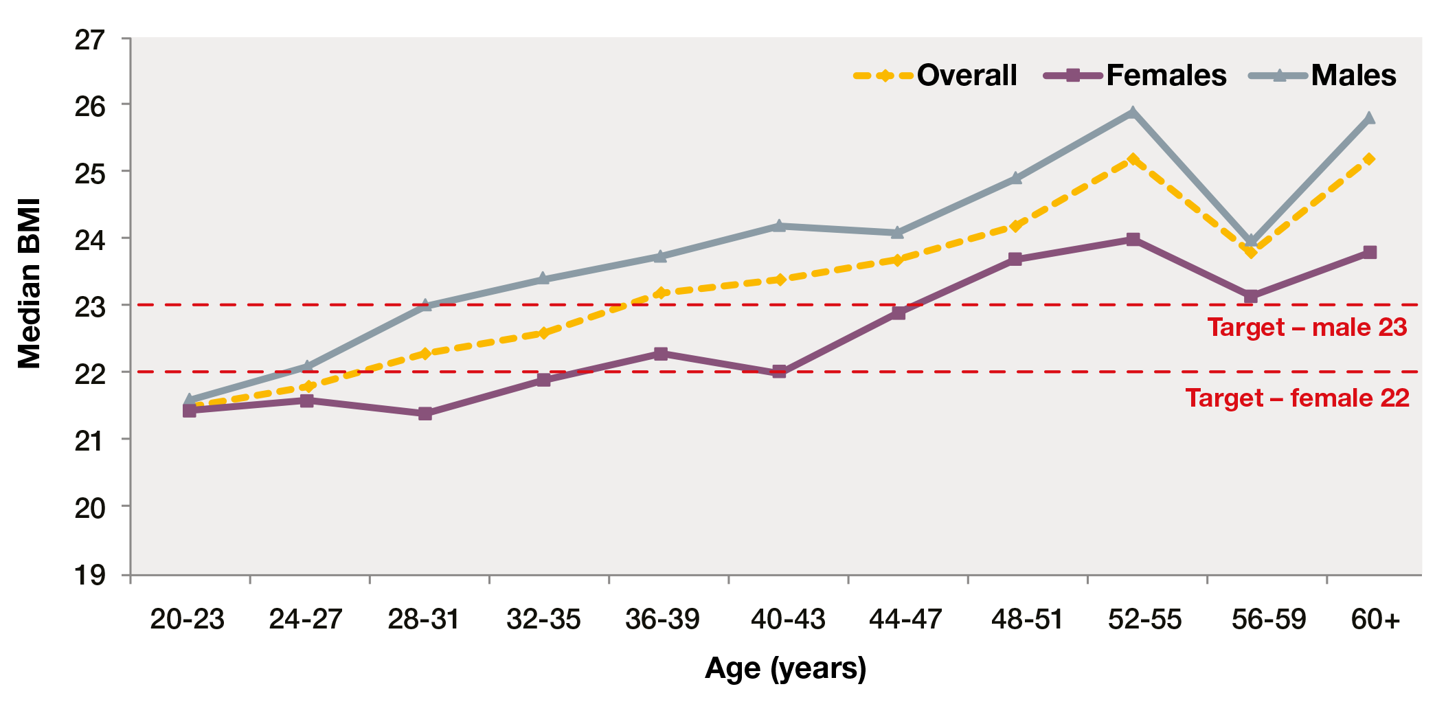
1.6 Body Mass Index (BMI) in adults (20 years and over) N=5071

Slide 8
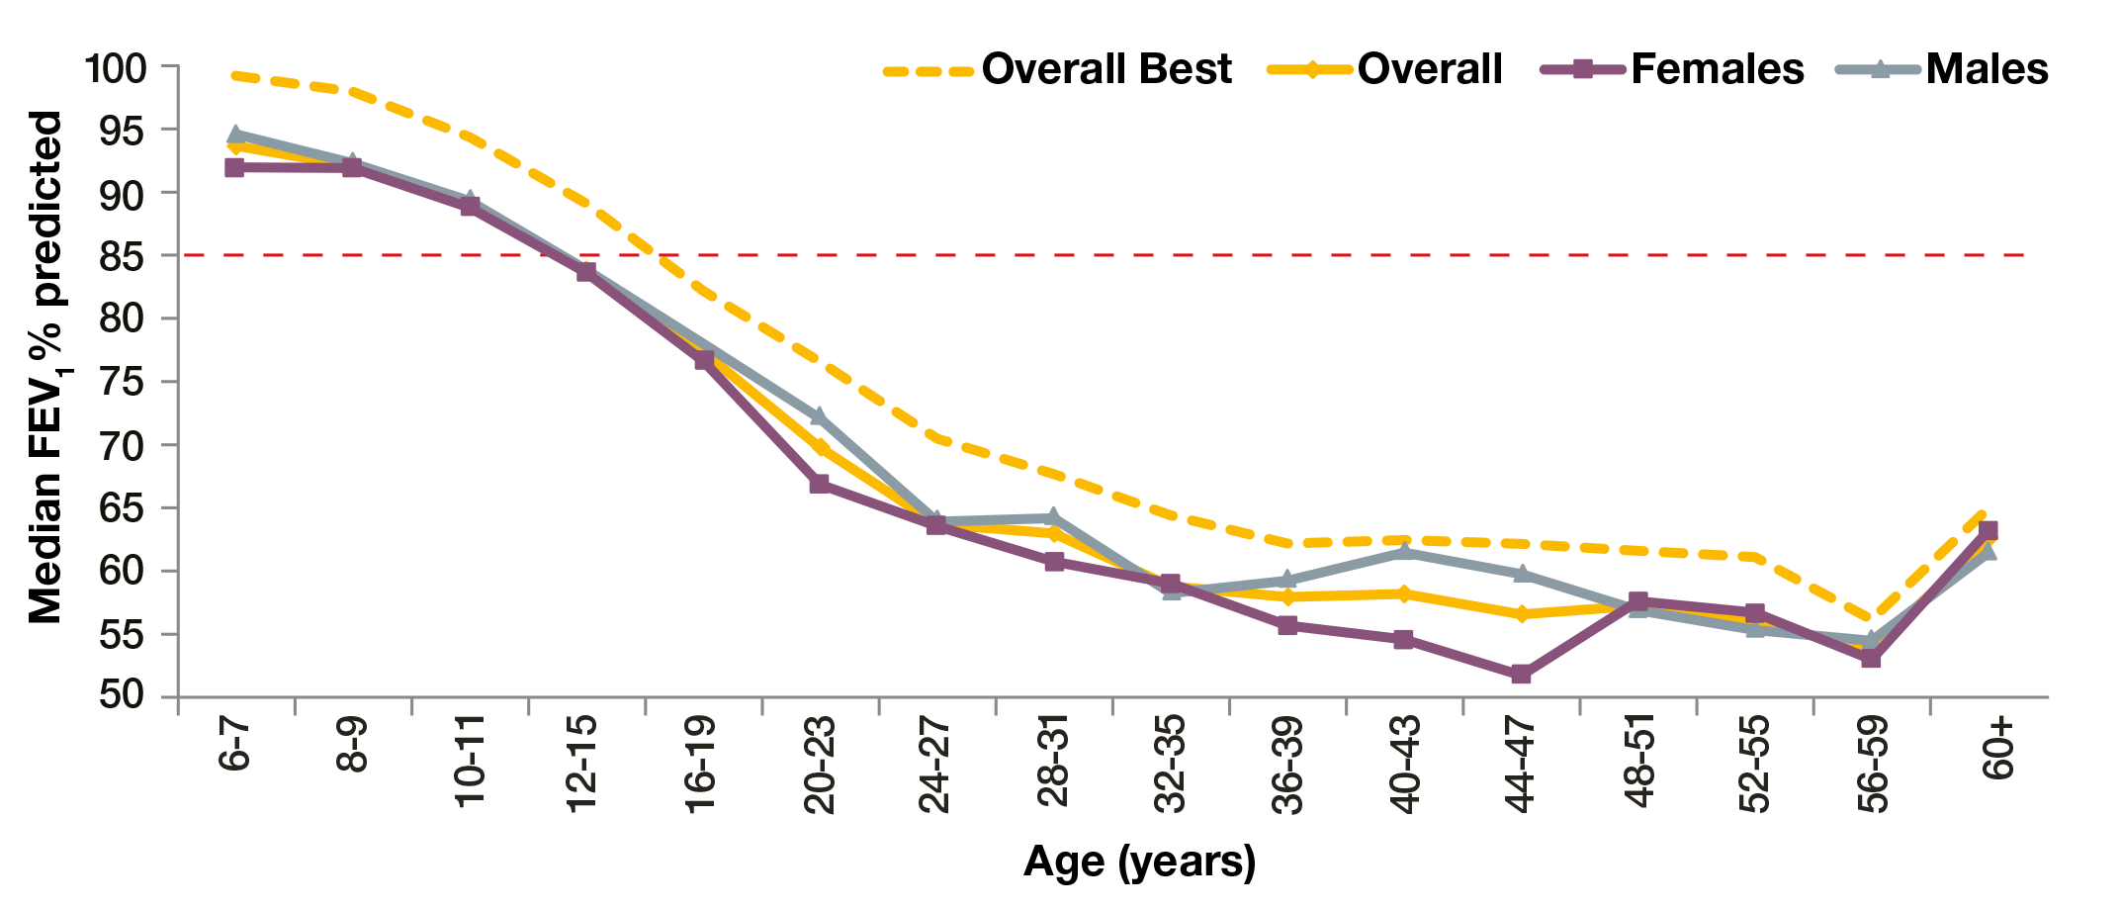
1.12 FEV1% predicted (GLI equations) in patients aged six years and older who have not had a lung transplant N=8168

Slide 9
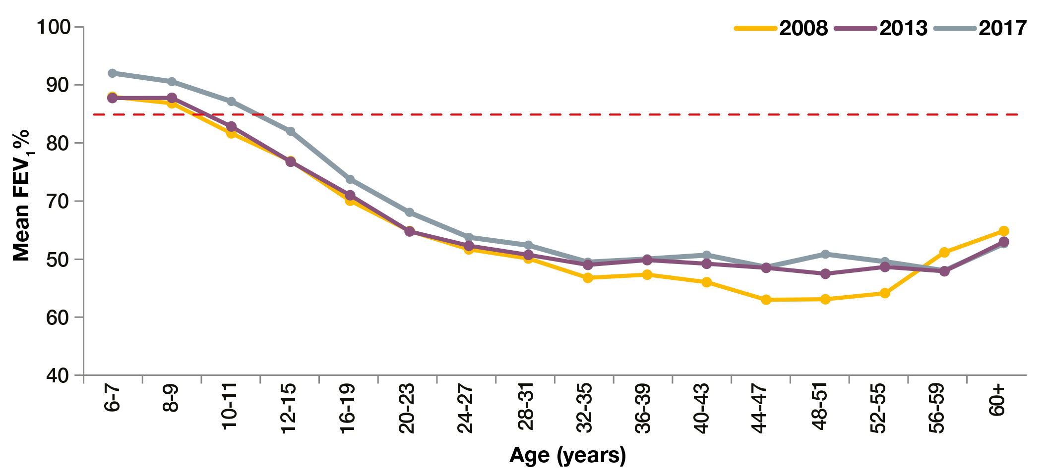
1.14 FEV1% predicted (GLI equations) over time in patients six years and older who have not had a lung transplant
N=8168 in 2017, N=7268 in 2013, N=5049 in 2008*

Slide 10
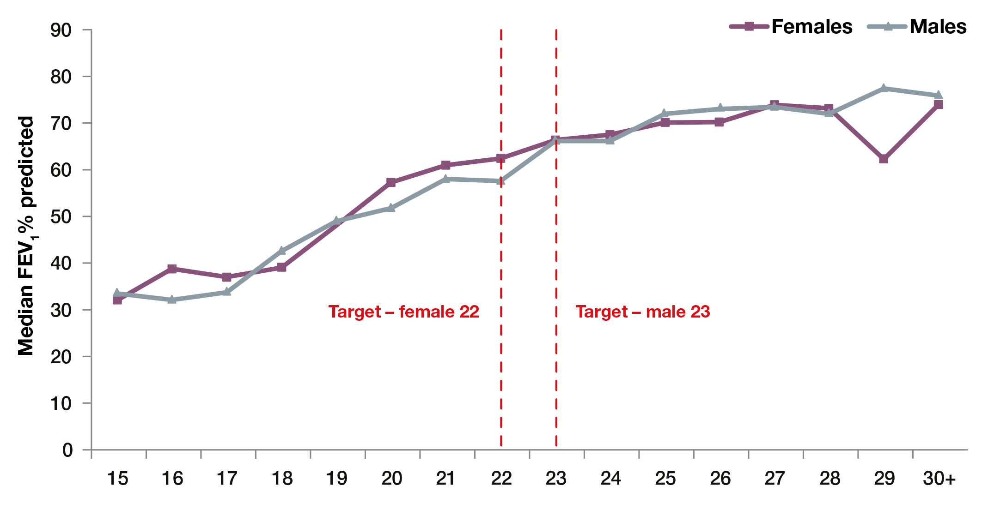
1.15 FEV1% predicted (GLI equations) and BMI in people aged 20 years and over who have not had a transplant N=4764

Slide 11
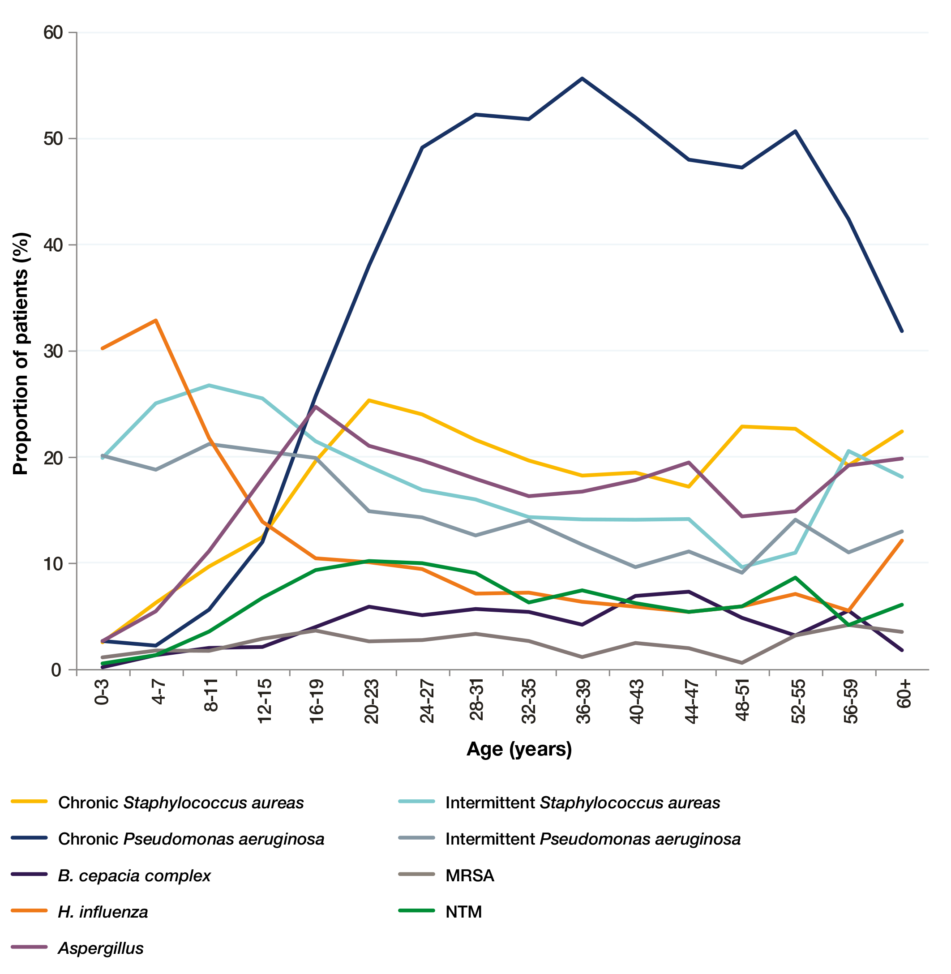
1.16 Lung infections in 2017 N=9887

Slide 12
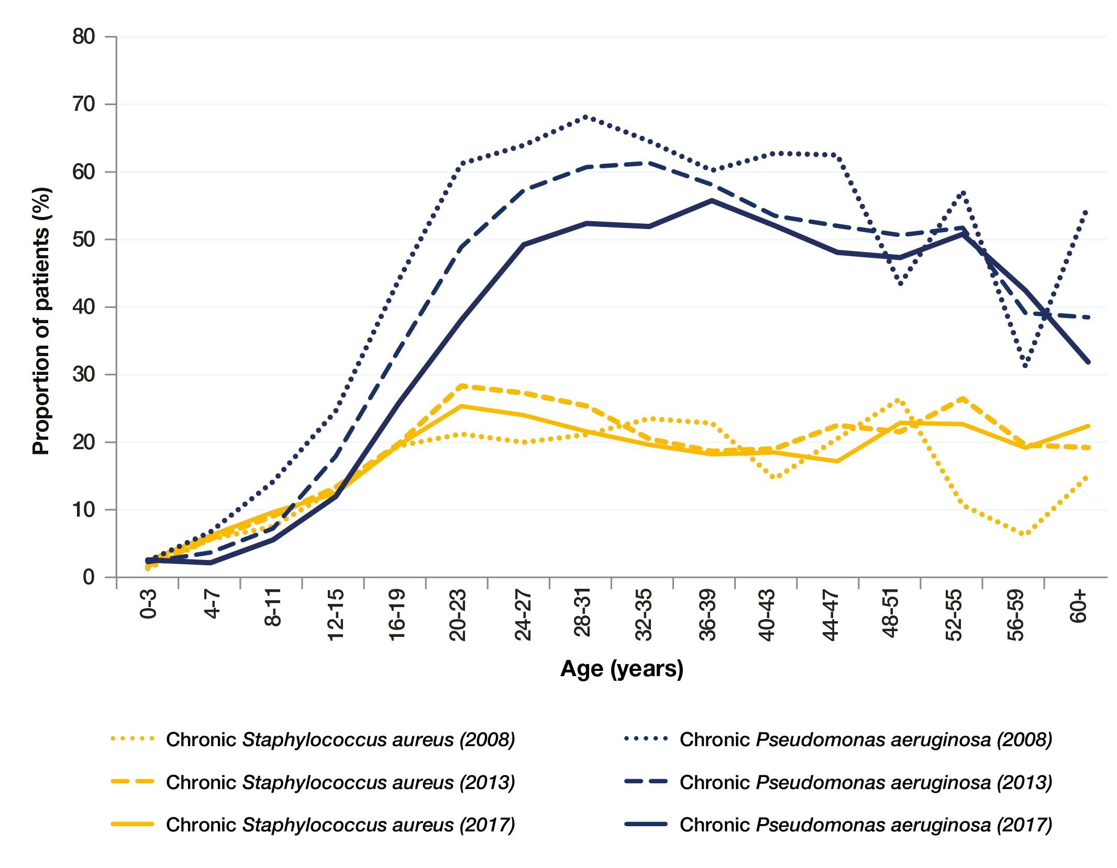
1.19 Lung infections over time
N=6082 in 2008, N=9052 in 2013, N=9887 in 2017

Slide 13
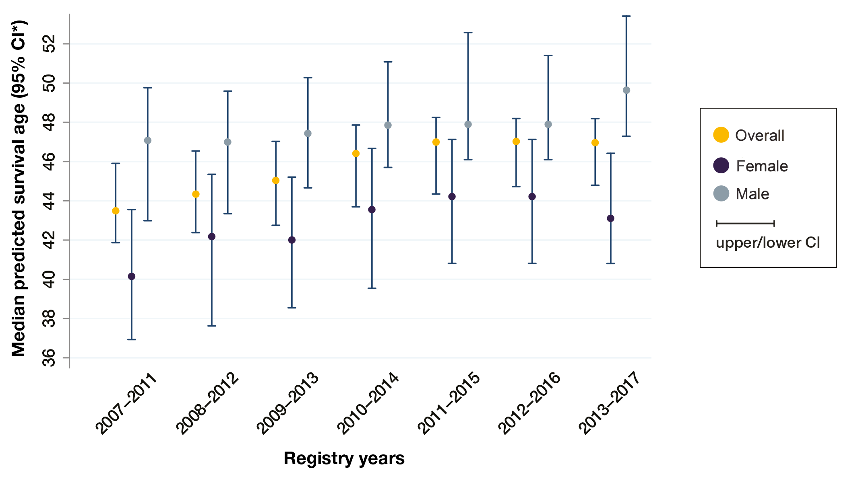
1.36 Median predicted survival age

Slide 14
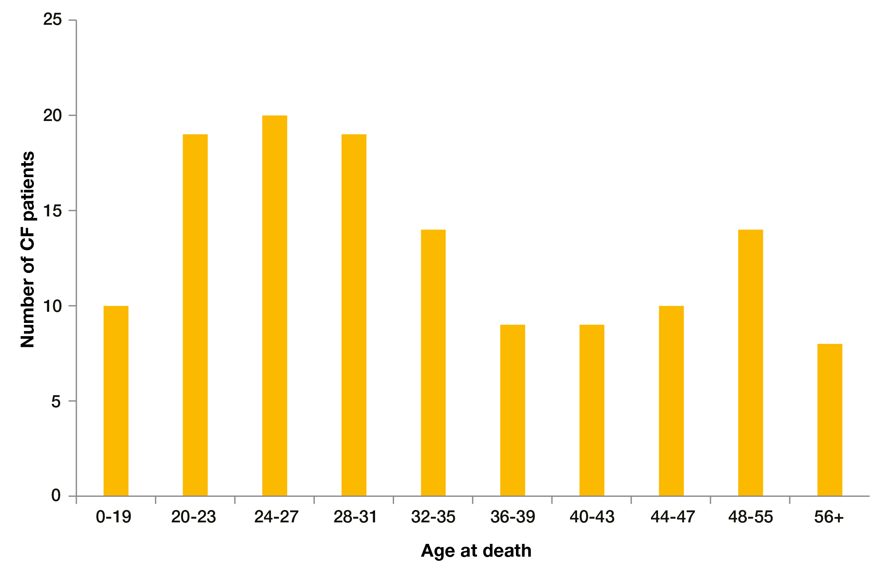
1.37 Age distribution of deaths in 2017

