Slide 1
Living with Cystic Fibrosis

Slide 2
In this lesson, we'll...
Learn about the condition cystic fibrosis (CF).or wear glasses.
Consider how CF affects people's physical and mental health and wellbeing.
Think about body image and body positivity.

Slide 3
What is cystic fibrosis (CF)?
Cystic fibrosis (CF) is a genetic condition. A baby is born with CF if both parents have a variant of the cystic fibrosis gene. We have two copies of each gene: one set we inherit from each parent. To have CF, both CF genes need to be affected by a gene fault.
If only one copy of the CF gene is affected, then the person is a carrier. Most people will not know they are carriers, since as a carrier you are unlikely to have any CF symptoms.
Around 1 in 25 people carry a CF gene variant. If both parents carry the CF gene, there is a one in four chance that their baby will have CF. This is the same for each pregnancy.
Notes:
You'll need to select the option to 'enable content' at the start of this slide show presentation, in order to be able to view the videos.

Slide 4
An invisible condition?
Over 10,800 people in the UK are living with cystic fibrosis (CF), but the condition is still widely misunderstood.
It's often described as an invisible condition because you can't see it or what it does to the body.

Slide 5
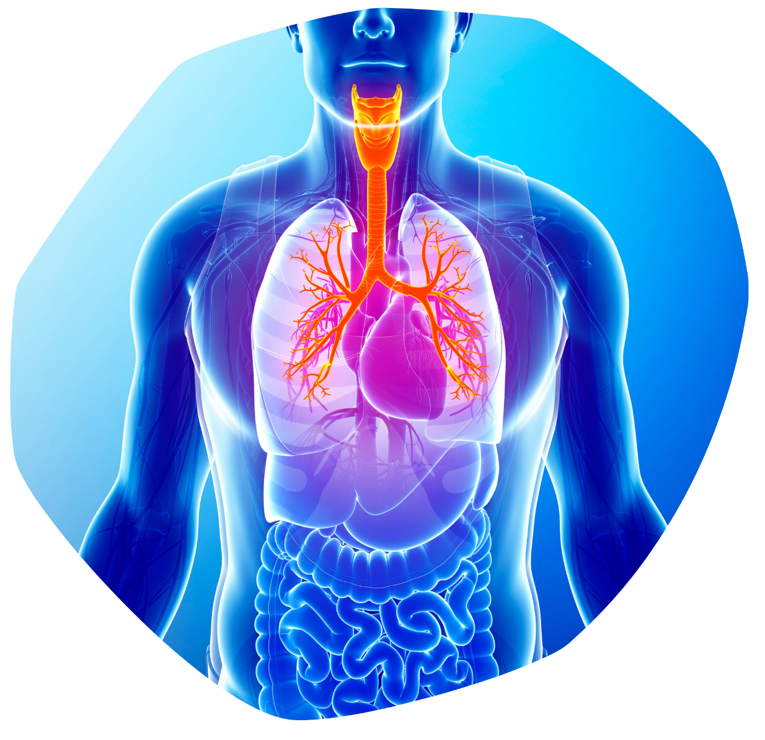
How CF affects the body
People with CF experience a build-up of thick, sticky mucus in the lungs, digestive system and other organs, causing a wide range of challenging symptoms affecting the entire body.
CF is a lifelong (or chronic) condition. It can't be cured but there are a lot of treatments, including medication, that are used to manage the symptoms.

Slide 6
Physical health and wellbeing
For people with CF, the way their lungs and stomachs work is often affected. Staying physically well may require a significant amount of time and effort, eating a special diet and undergoing a range of treatments.
Let's find out about staying physically well with CF.

Slide 7
Physical challenges
What physical challenges might a person with CF face?
How might these impact a person's day-to-day life?
What might people with CF do to manage the physical challenges they face, due to their condition?

Slide 8
Mental health and wellbeing
Do you think having a medical condition that affects you physically can also impact your mental health and wellbeing?
Let's find out about staying mentally well with CF.

Slide 9
Mental challenges
How might living with CF affect a person's mental health?
What thoughts and feelings might a person with CF experience relating to their condition?
What strategies might a person with CF use to protect their mental health and wellbeing?

Slide 10
The body image issue
Body image is how you view your physical self, and how you think others see you.
What might influence the way a person views themselves?
Body image may be influenced by many factors:
Individual thoughts, beliefs, feelings and behaviours about our bodies.
What we believe counts as the ‘ideal body’ (which we learn from our families, culture, society and the media).
External factors like illness, accidents and disability that can change how our bodies look or what they can do.

Slide 11
"When we can truly notice all the negative outside influences we have experienced that affect how we feel about our bodies, we can start choosing to ignore them, focussing on our bodies' strength and abilities instead, and begin feeling much more body confident."
(CF Psychologist)

Slide 12
Body image and CF
Body image is one aspect that some people with CF might find challenging.
Let's find out more.

Slide 13
Body positivity
Body image is an important topic for everyone to consider. Being dissatisfied with our body image can lead to low self-esteem.
Certain ways of thinking and behaviours can affect how we view our physical selves – either negatively or positively.
Record thoughts and practices on your sheet that you think could support body positivity.

Slide 14
The bigger picture
Do you think there is more that can be done to promote positive body image?
Consider to what extent you agree with the following statements:
The Advertising Standards Authority should restrict adverts relating to idealistic appearances, such as adverts for beauty products, weight-loss products and services, and cosmetic surgery companies.
Companies should use a diverse range of people in their advertising campaigns.
Social media companies should investigate new ways of promoting body positivity on their platforms.
Social media companies should have clear systems for users to report bullying and discrimination.
Learning about body image should be on the curriculum for all schools.

Slide 15
Awareness and understanding
Awareness and understanding lead to acceptance and kindness.
Whether it's empathising with people who have a medical condition, or being kind to ourselves when we look in the mirror, arming ourselves with knowledge and listening to others' experiences is key.

Slide 16
Let's recap...
We've learnt a lot about cystic fibrosis today and we've thought about how it impacts the lives of people with the condition.
We've also considered how body image can affect everyone, including people with a medical condition like CF, and how to promote body positivity.
Let's hear from some more young people about what it's like living with CF.

Slide 18
Cystic Fibrosis Trust is a UK charity who support people with CF and help fund research into treatments for the condition.
Think about everything we have learnt today about people who have CF. Why do you think Cystic Fibrosis Trust use the phrase 'Uniting for a life unlimited' in their campaign work?

