Slide 1
CF is for Cystic Fibrosis
Notes:
You'll need to select the option to 'enable content' at the start of this slide show presentation, in order to be able to view the videos.

Slide 2
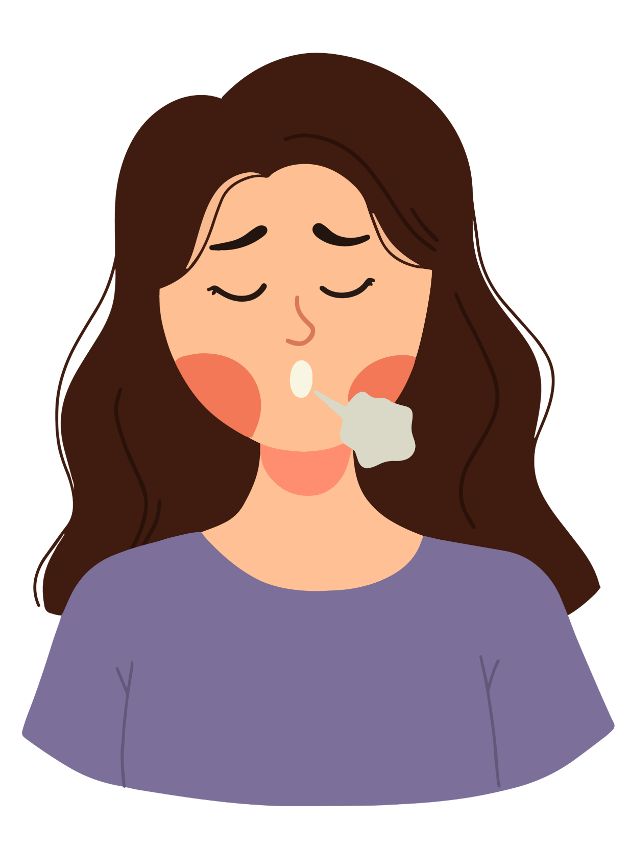
In this lesson, we will learn...
What the condition called cystic fibrosis is.
How cystic fibrosis affects the body.
What life is like for children who have cystic fibrosis.

Slide 3
What is cystic fibrosis?
You might not have heard of cystic fibrosis (or CF), but it affects a lot of people. In fact, nearly 11,000 people in the UK have the condition.
People with CF have inherited it. It can only be inherited if both parents carry the gene variant that causes it. Around 1 in 25 people carry the CF gene variant, but most won't know it.
CF is a disease that some people are born with. You can't catch it, like the flu or chicken pox.
CF is a lifelong condition. There is no cure but there are lots of treatments to help the people who have it.

Slide 4
How does CF affect the body?
Do you know whereabouts your lungs are in your body?
Do you know what job they do?
Do you know anything about the digestive system?
CF causes thick sticky mucus to build up in the lungs, the digestive system and other organs. This can then cause lots of problems for people with CF.

Slide 5
An A to Z of cystic fibrosis
To learn more about CF, we can watch a video about it, starring some children who have the condition.

Slide 6
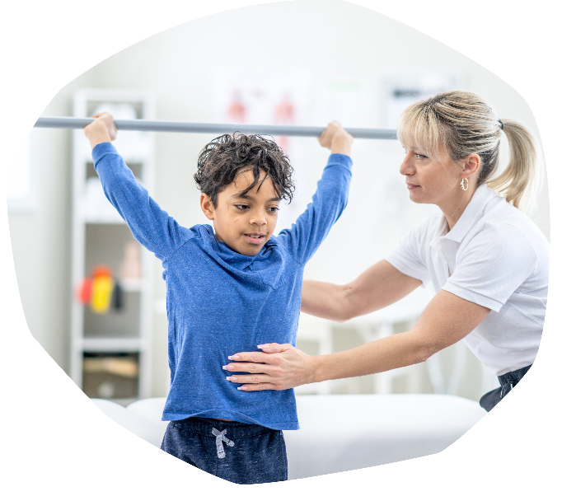
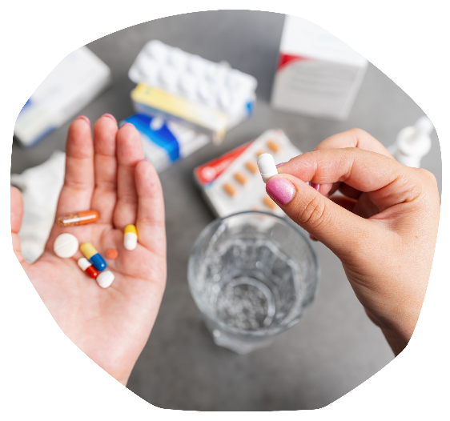
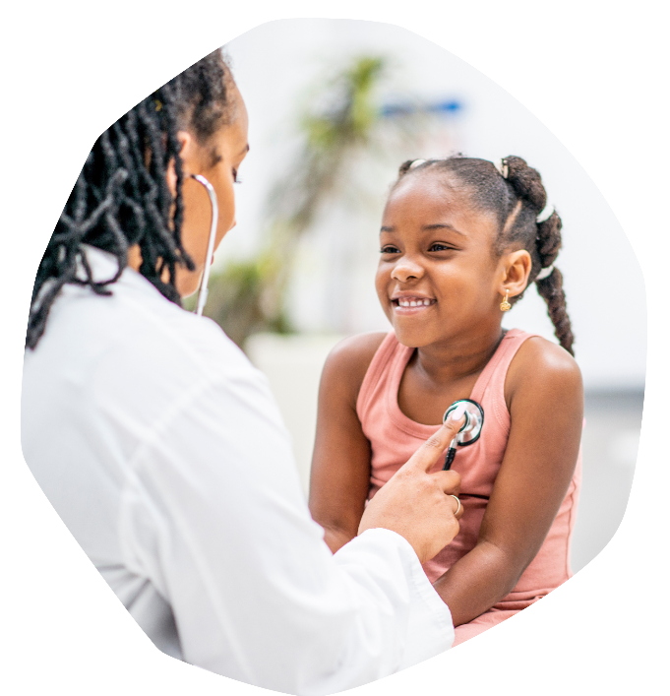
Treatment for CF
As we saw in the video, there are lots of ways that children with CF manage their CF. Everyone is different so treatment doesn't look the same for every person with CF.
They have regular check-ups and x-rays.
They breathe in medicine using a nebuliser.
They eat foods that will help them maintain the right weight.
They take enzymes with their meals.
They make sure they don't meet face-to-face with other people with CF.
They take antibiotics if they get an infection.
They see a physiotherapist and get lots of exercise.
And they make sure they get plenty of rest.

Slide 7
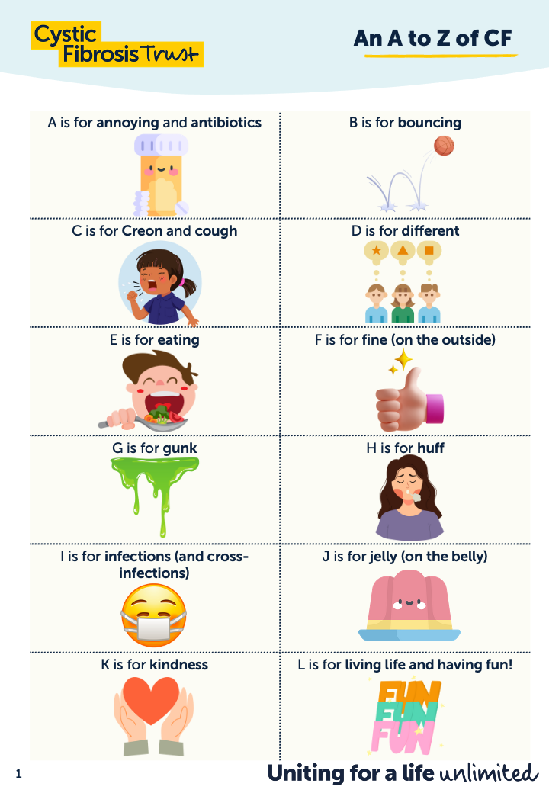
It's time for a quiz!
Let's use the information we have learnt so far to answer some questions about CF.
You can use the A to Z of CF Handout to help you.

Slide 8
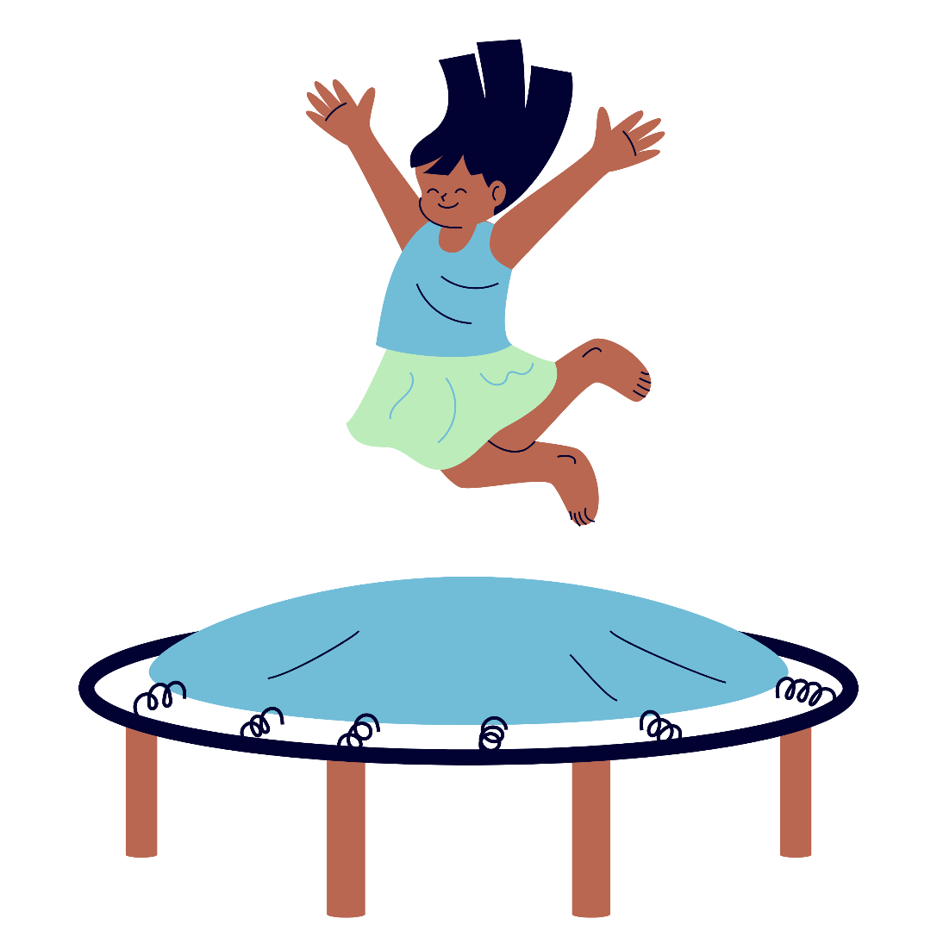
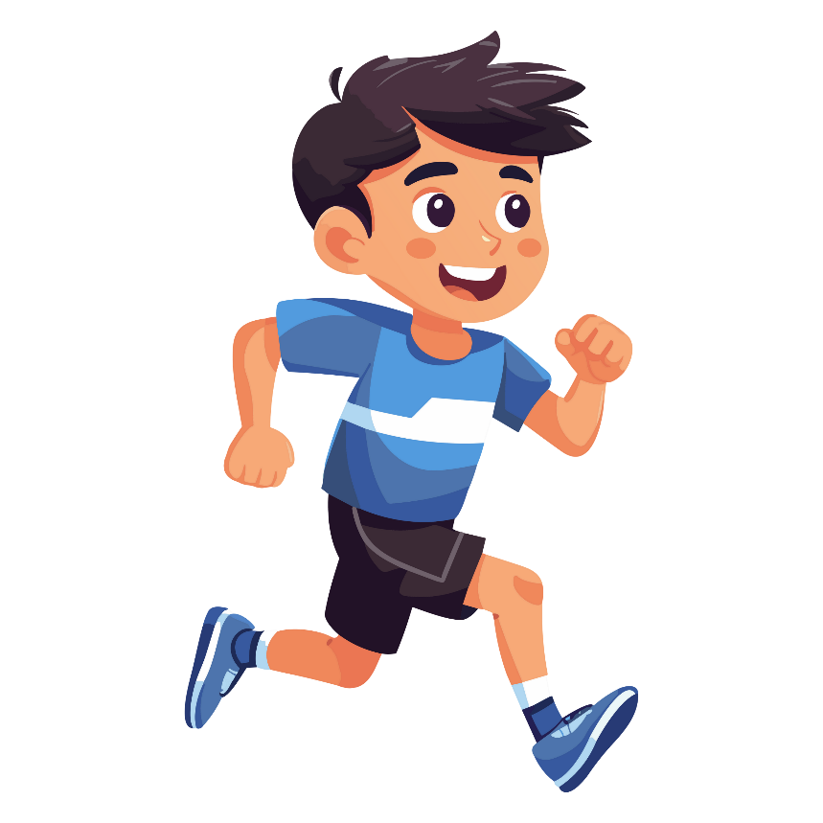
How did you get on?
1. Bouncing and running.

Slide 9
How did you get on?
2. Gunk.

Slide 10
How did you get on?
3. A stethoscope.

Slide 11
How did you get on?
4. Creon.

Slide 12
How did you get on?
5. Obstreperous.

Slide 13
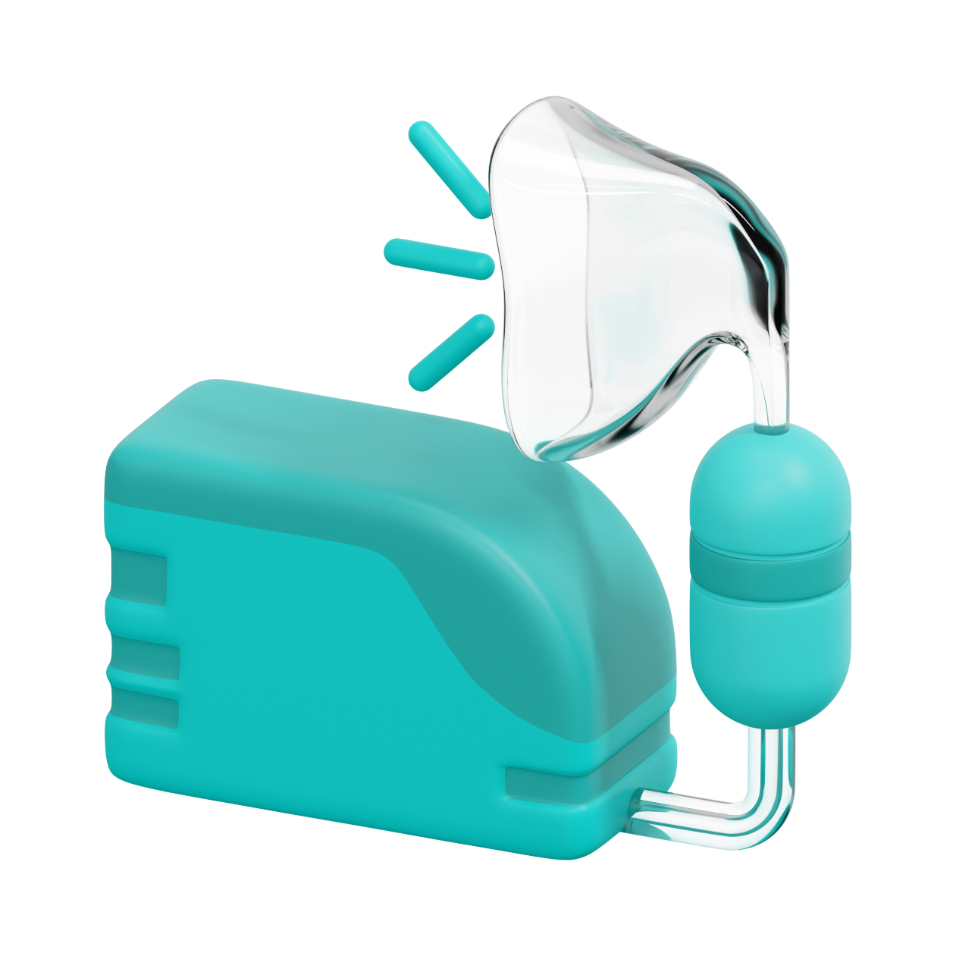
How did you get on?
6. A nebuliser.

Slide 14
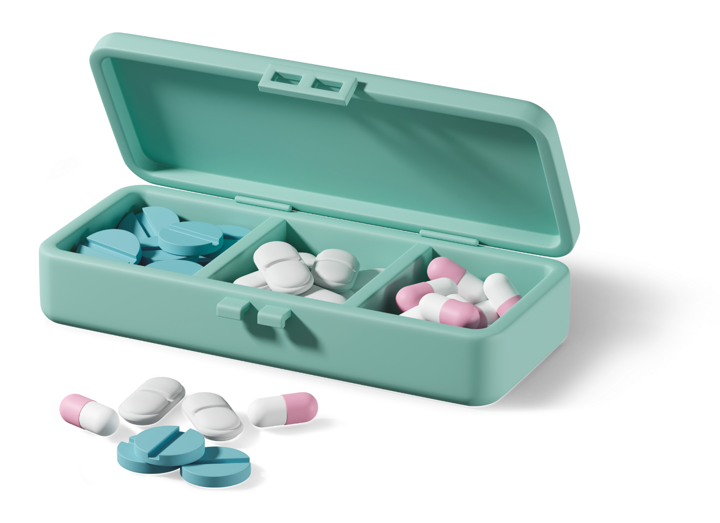
How did you get on?
7. Nearly 40 tablets a day.

Slide 15
How did you get on?
8. Vomit.

Slide 16
How did you get on?
9. Thicker and stickier.

Slide 17
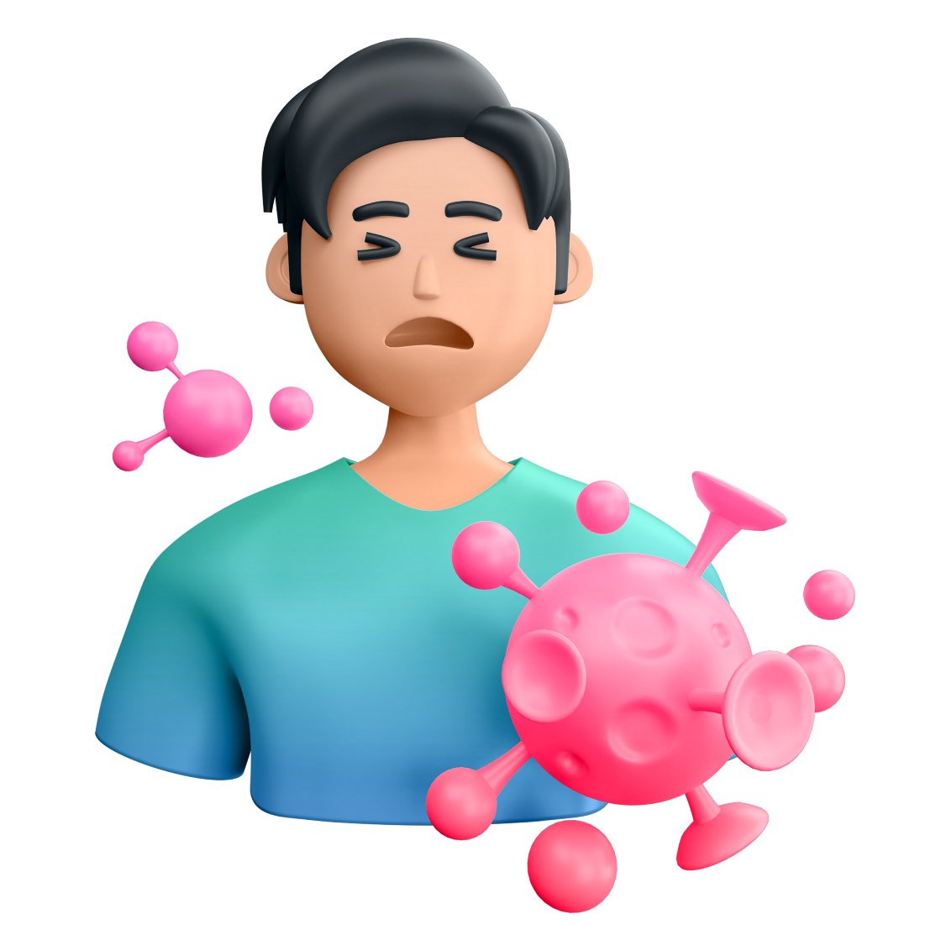
How did you get on?
10. No, CF is not contagious.

Slide 18
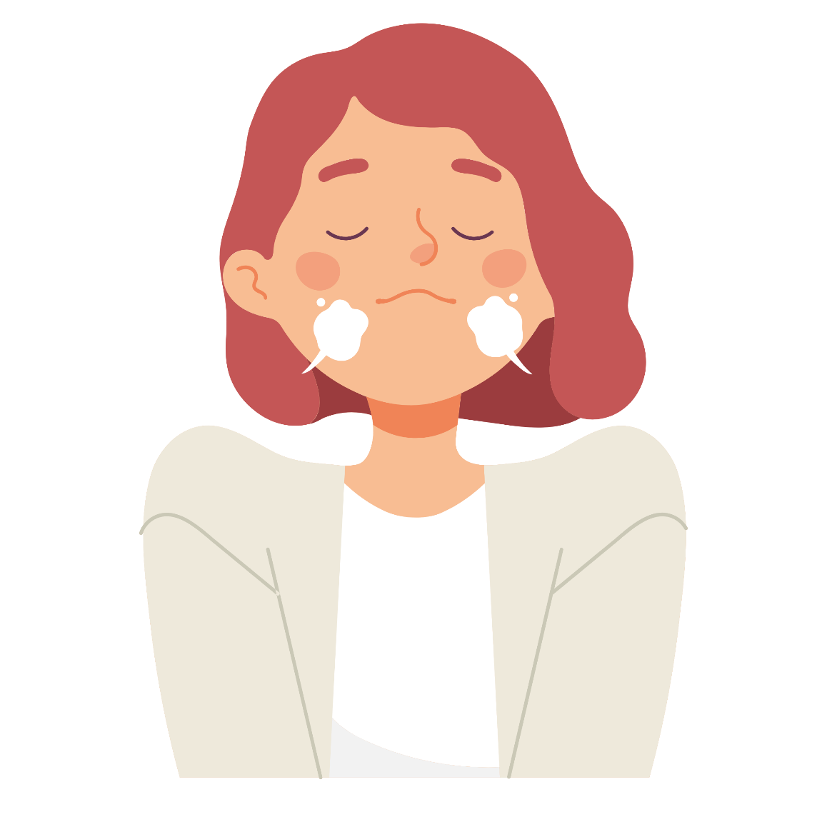
How did you get on?
11. Huff.

Slide 19
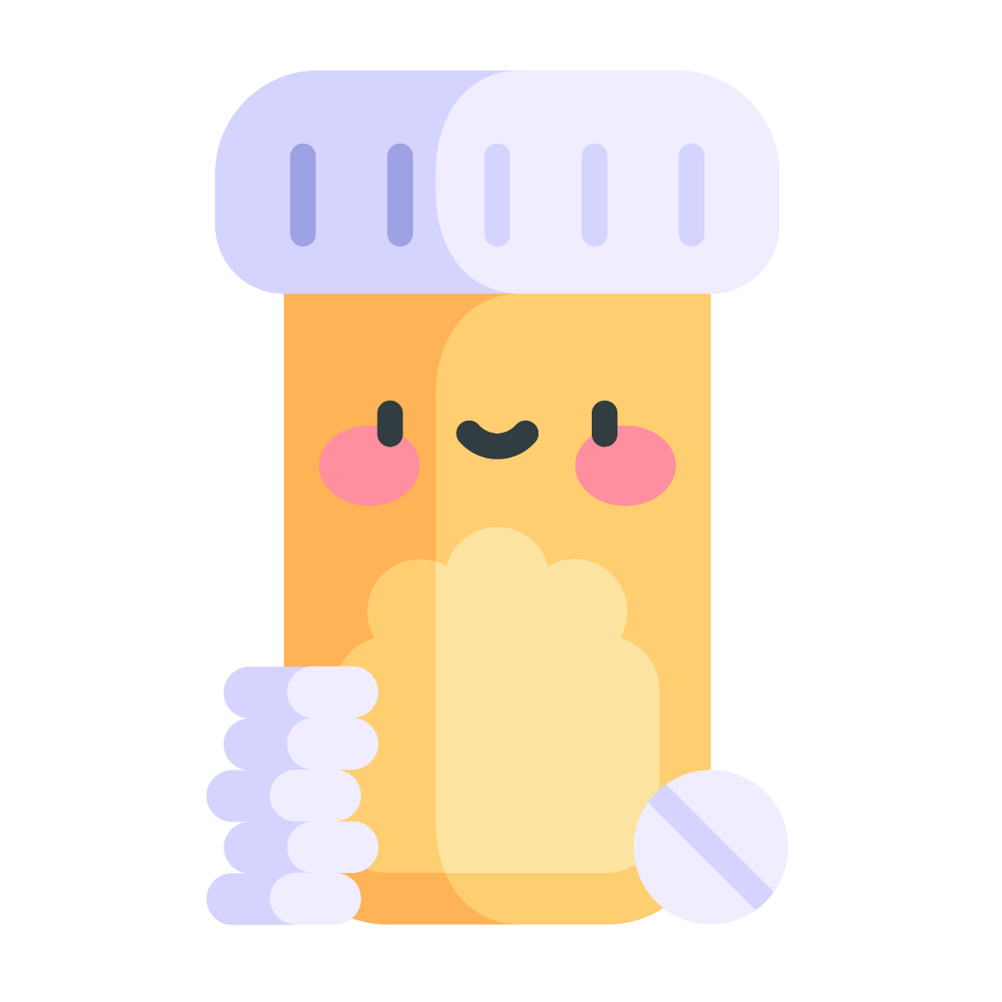
How did you get on?
12. Antibiotics.

Slide 20
How did you get on?
13. Once a year.

Slide 21
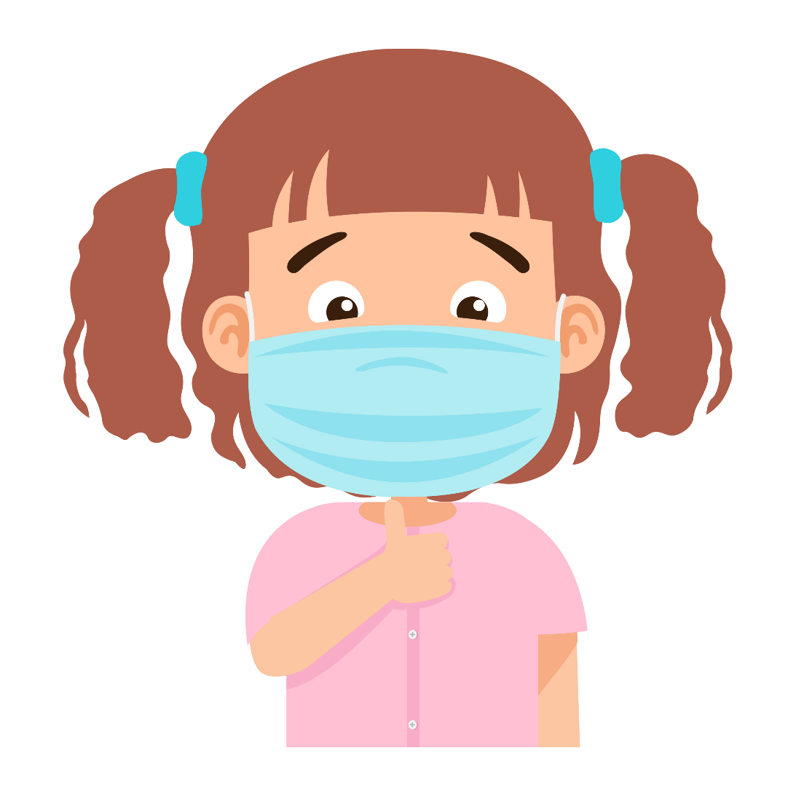
How did you get on?
14. The bugs that people with CF carry in their lungs would be dangerous for another person with CF and could cause a serious infection.

Slide 22
How did you get on?
15. Kindness and understanding.
Is there anything you don't understand about CF or anything else you'd like to ask about CF?

Slide 23
Living with CF
What do you think it might be like to live with CF?
What are some things a child with CF might have to do that you don't have to do?
How could you support a friend with CF?

Slide 24
Understanding life with CF
To get an even better understanding of what it's like to live with CF, we can watch another video. This one is called 'CF: What's it all about?'. It will remind us of some of the things we have learnt today.

Slide 25
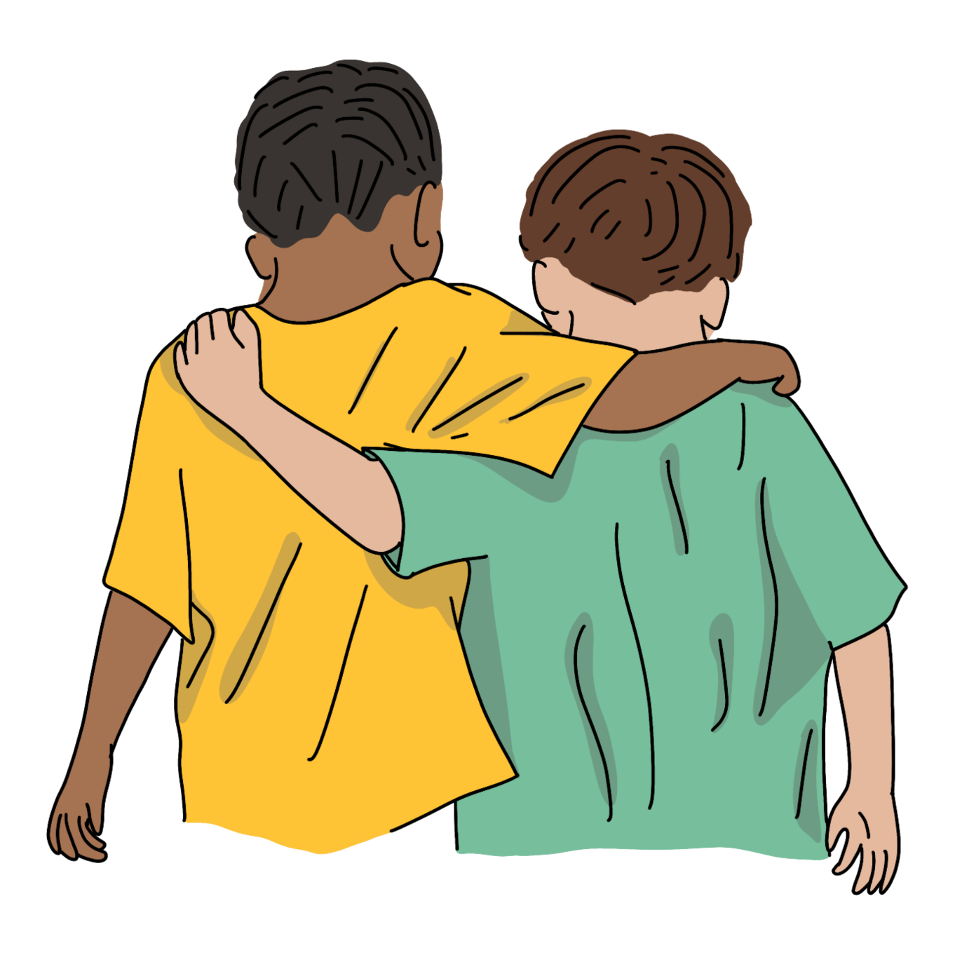
Same, but different
What do you have in common with any of the children in the video?
What are some differences between you and the children in the video?
What would you like to ask the children in the video or say to them if you met them?

Slide 26
Today, we have...
Learnt about the condition cystic fibrosis.
Learnt about how CF affects the body.
Learnt about what life is like for children who have CF.

