Slide 1
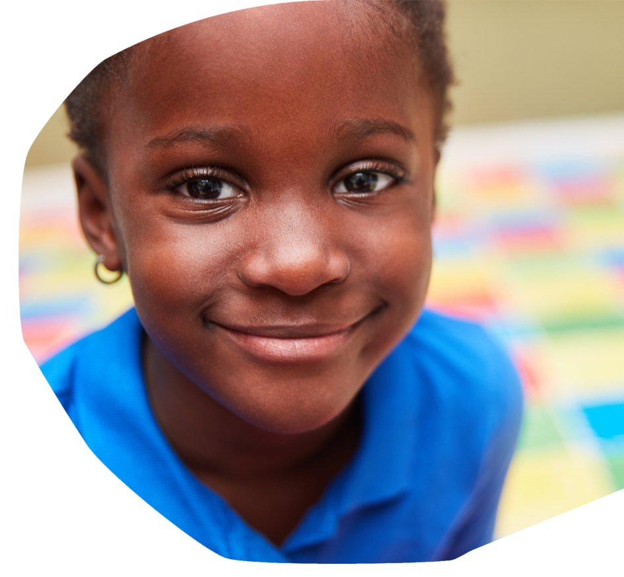




All About Me,
All About You
Notes:
You’ll need to select ‘enable content’ at the start of this slide show presentation, in order to be able to watch the video content.

Slide 2

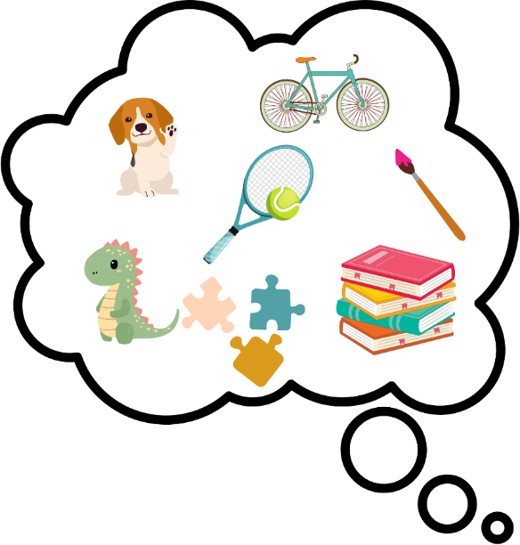



What makes you, you?
Have a think about your interests and hobbies.
What games or sports do you like to play?
Do you have a favourite animal?
How might other people describe you?

Slide 3


What we like: similarities and differences
We are all unique! That means that no two people are completely identical.
But we all have similarities with other people. That means that we have something in common.
​Can you and the person next to you think of something you have in common? ​
Perhaps there's a type of food or a TV programme you both like.

Slide 4
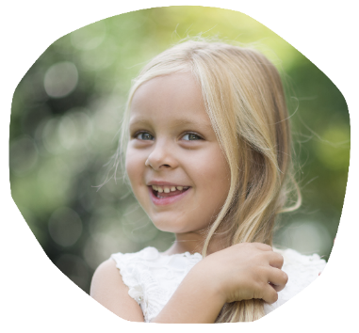
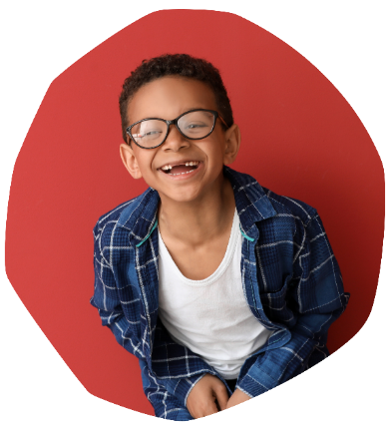
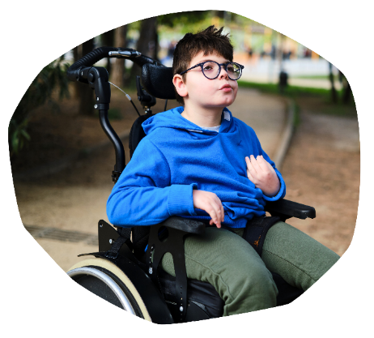


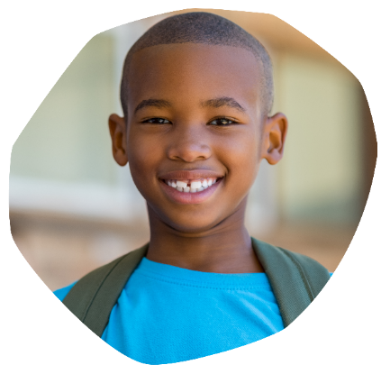

Our bodies: similarities and differences
We can also find things we have in common with others about our bodies...
Two people might have the same hair colour, have a birthmark or wear glasses.
Two people might use a wheelchair or wear the same sized shoes.
We might have the same allergy as someone else, the same condition, or take the same medication.

Slide 5

Common conditions
A medical condition is something that affects our bodies.
You might have heard of common conditions like asthma, eczema and hayfever.
We're going to meet some children in a video today and learn about a condition that they all have.

Slide 6
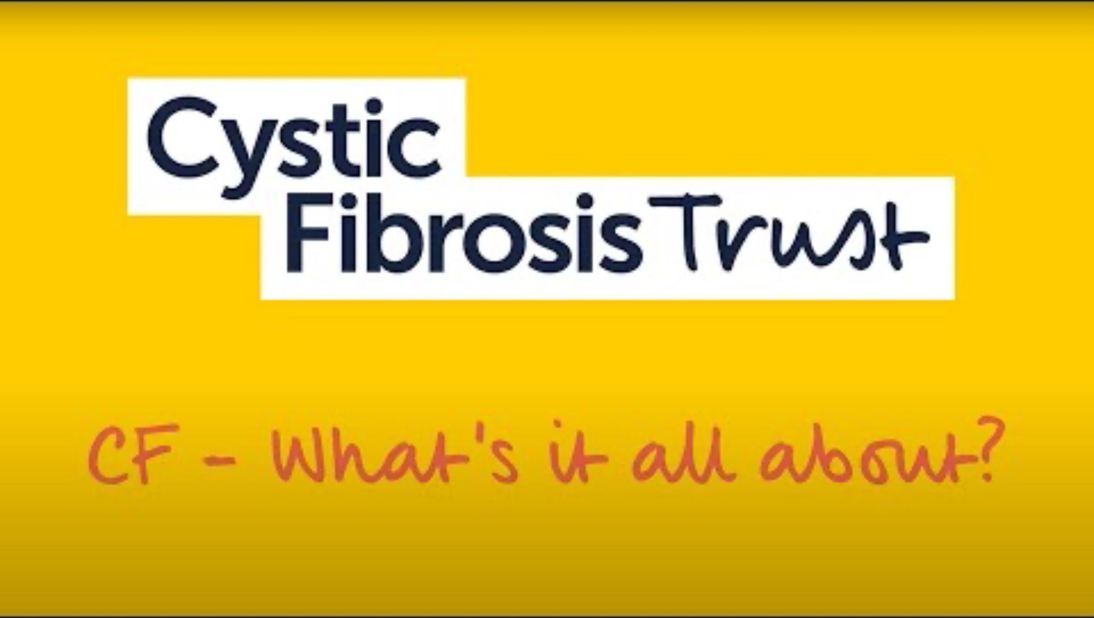

Slide 7



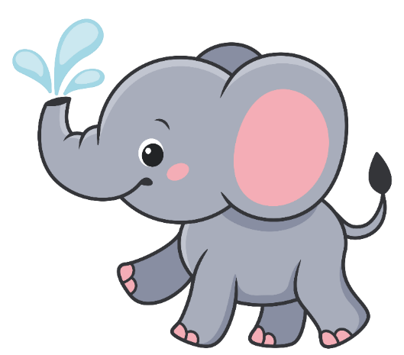
Who are you like?
In the video, we met Layla, Zaara, Jason, Jack and Noah (Jack's big brother).
Do you have something in common with one of these children?
Maybe you're the same age as one of them or maybe you like the same thing that they like.

Slide 8


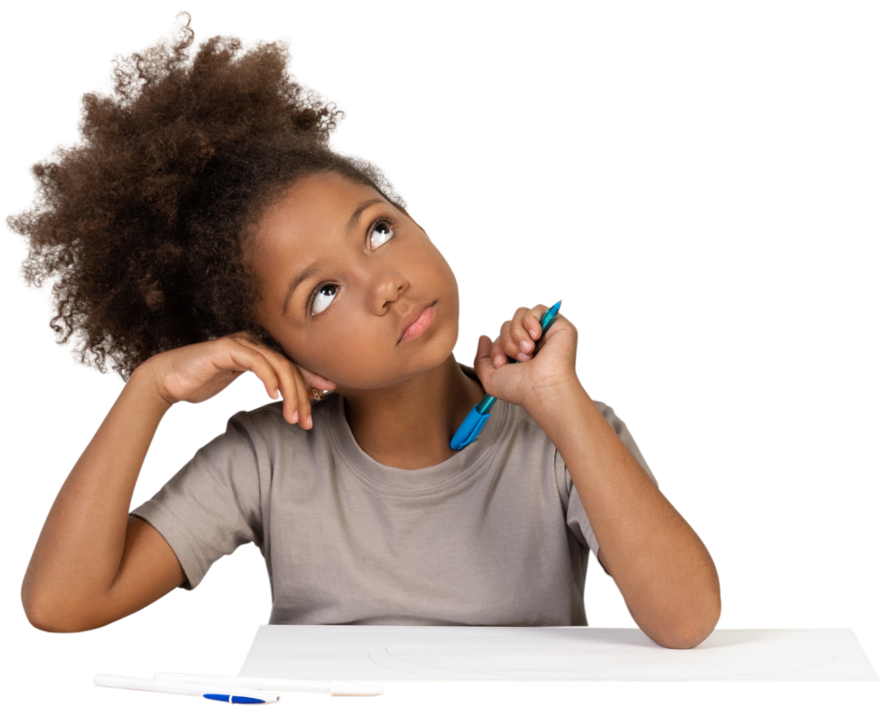

Different lives
Is there something about Layla, Zaara, Jason and Jack's lives that is different from your life?
Layla, Zaara, Jason and Jack all have cystic fibrosis – or CF. This means they might have to do certain things that you don't have to do.

Slide 9
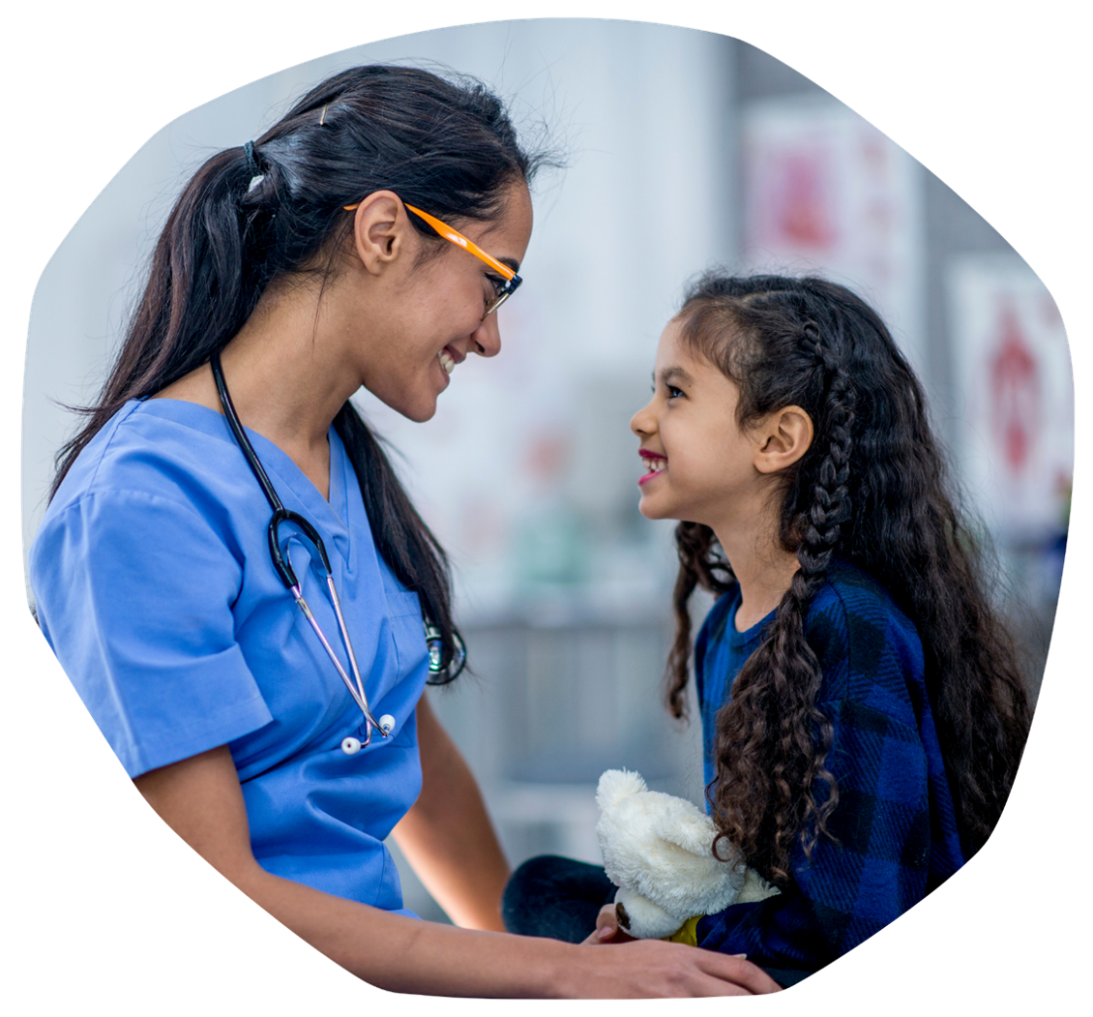
Treatments and medicines
Children with CF take treatments and medicines every day.
In the video, Zaara explains that when she gets sick, she has to take extra medicines called antibiotics.
Have you ever been prescribed antibiotics or other medicines by the doctor when you were poorly?

Slide 10

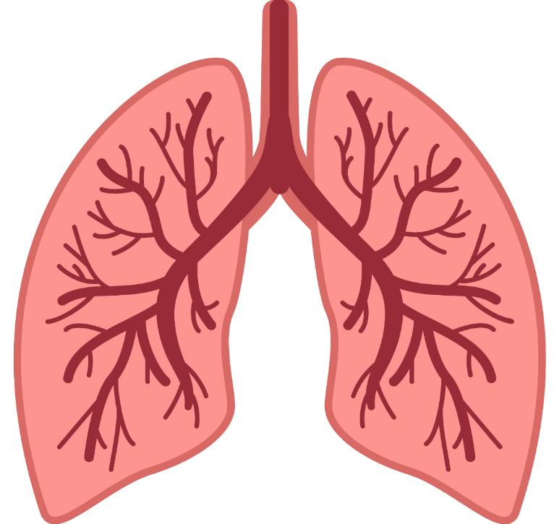

Different bodies: lungs
On the whole, our bodies all look similar and work in a similar way.
Do you know where your lungs are and what job they do?
We all have lungs to help us breathe, but children with CF have thicker, stickier mucus in their lungs which bugs can get stuck in. This then makes them ill.

Slide 11
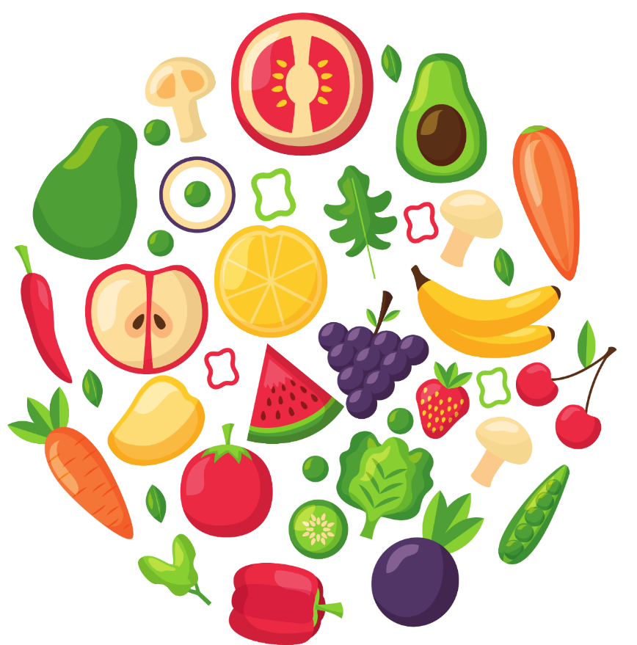



Different bodies: tummies
Our tummies (or stomachs) have an important job to do.
For most people with CF, their tummies work differently. They take enzymes (or Creon) capsules when they eat to help them get all the vitamins and minerals from their food that their body needs.
What's a healthy food that you enjoy?

Slide 12

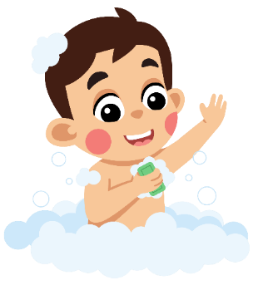


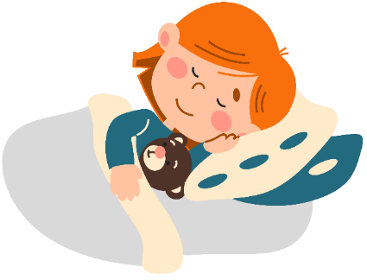
Looking after our bodies
Our bodies might work in slightly different ways, but one thing we all have in common is that we can look after our bodies.
How do you look after your body?
We can:
Eat healthy foods
Drink plenty of water
Keep our bodies clean
Get enough rest and sleep
Ask for help if we feel unwell or get hurt

Slide 13
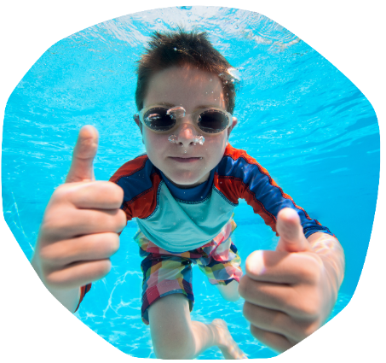
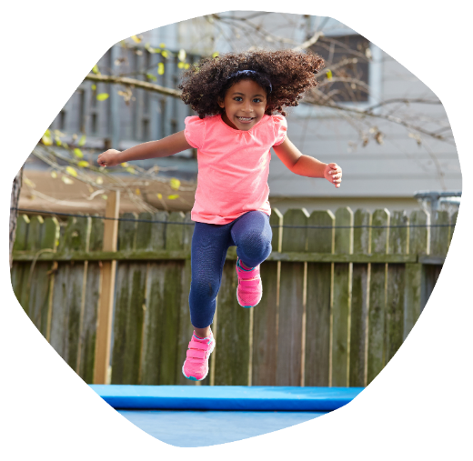
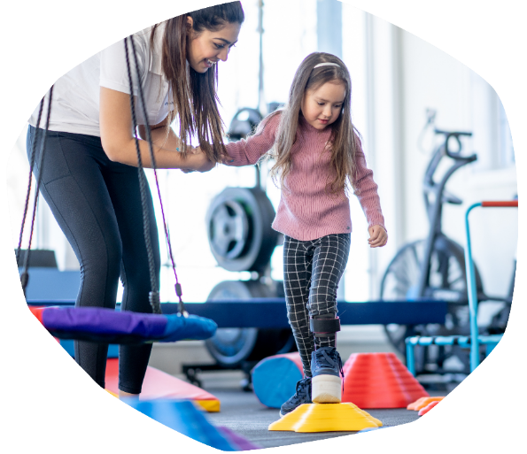
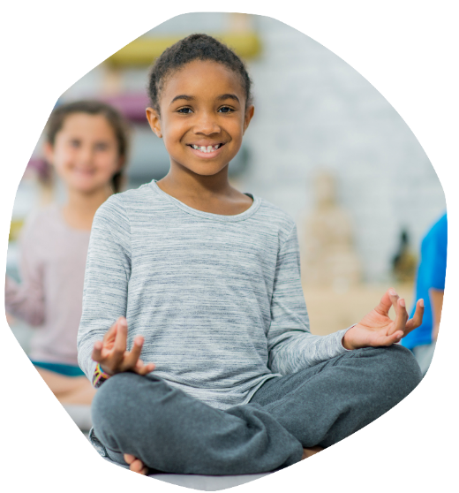
Excellent exercise
In the video, we learnt that the children with CF get lots of exercise to help keep their bodies healthy.
Exercise is great for us all and we can exercise in lots of different ways. Some people have help to move their bodies.
What are your favourite ways to exercise?

Slide 14
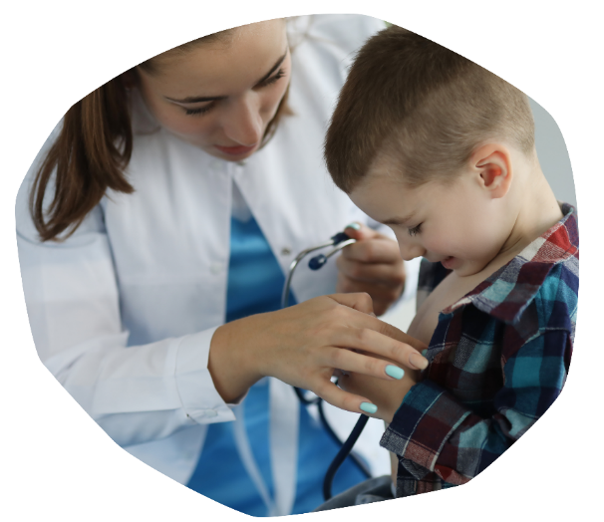
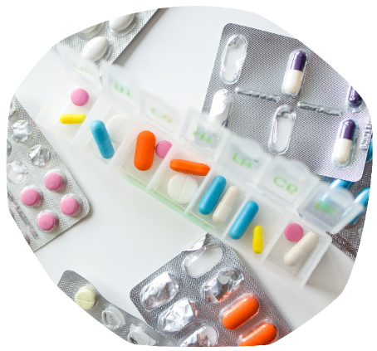
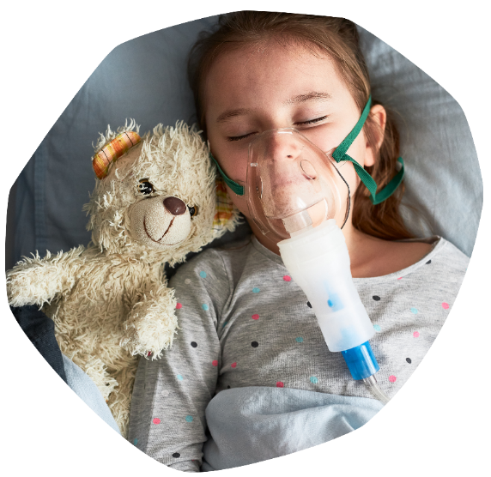
Living with CF
Today, we have learnt about the condition called cystic fibrosis (or CF).
Children with CF might be a little different from you and living with CF isn't always easy.
What do you think might be difficult about living with CF?

Slide 15
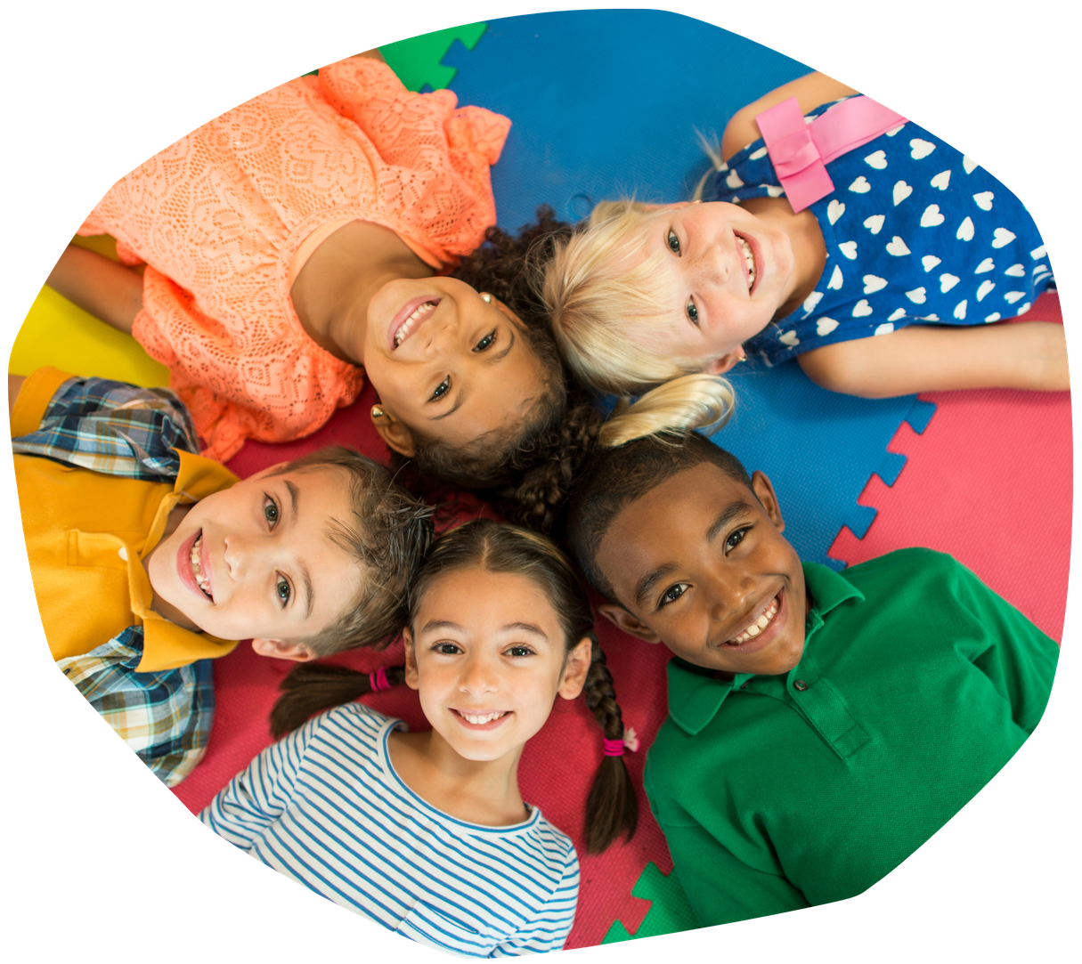

Living a life unlimited
Although, living with CF can be tricky, children with CF are children – just like you!
With support and understanding, and the right treatment, all children can live a happy life full of fun activities.

Slide 16


